Slide 1
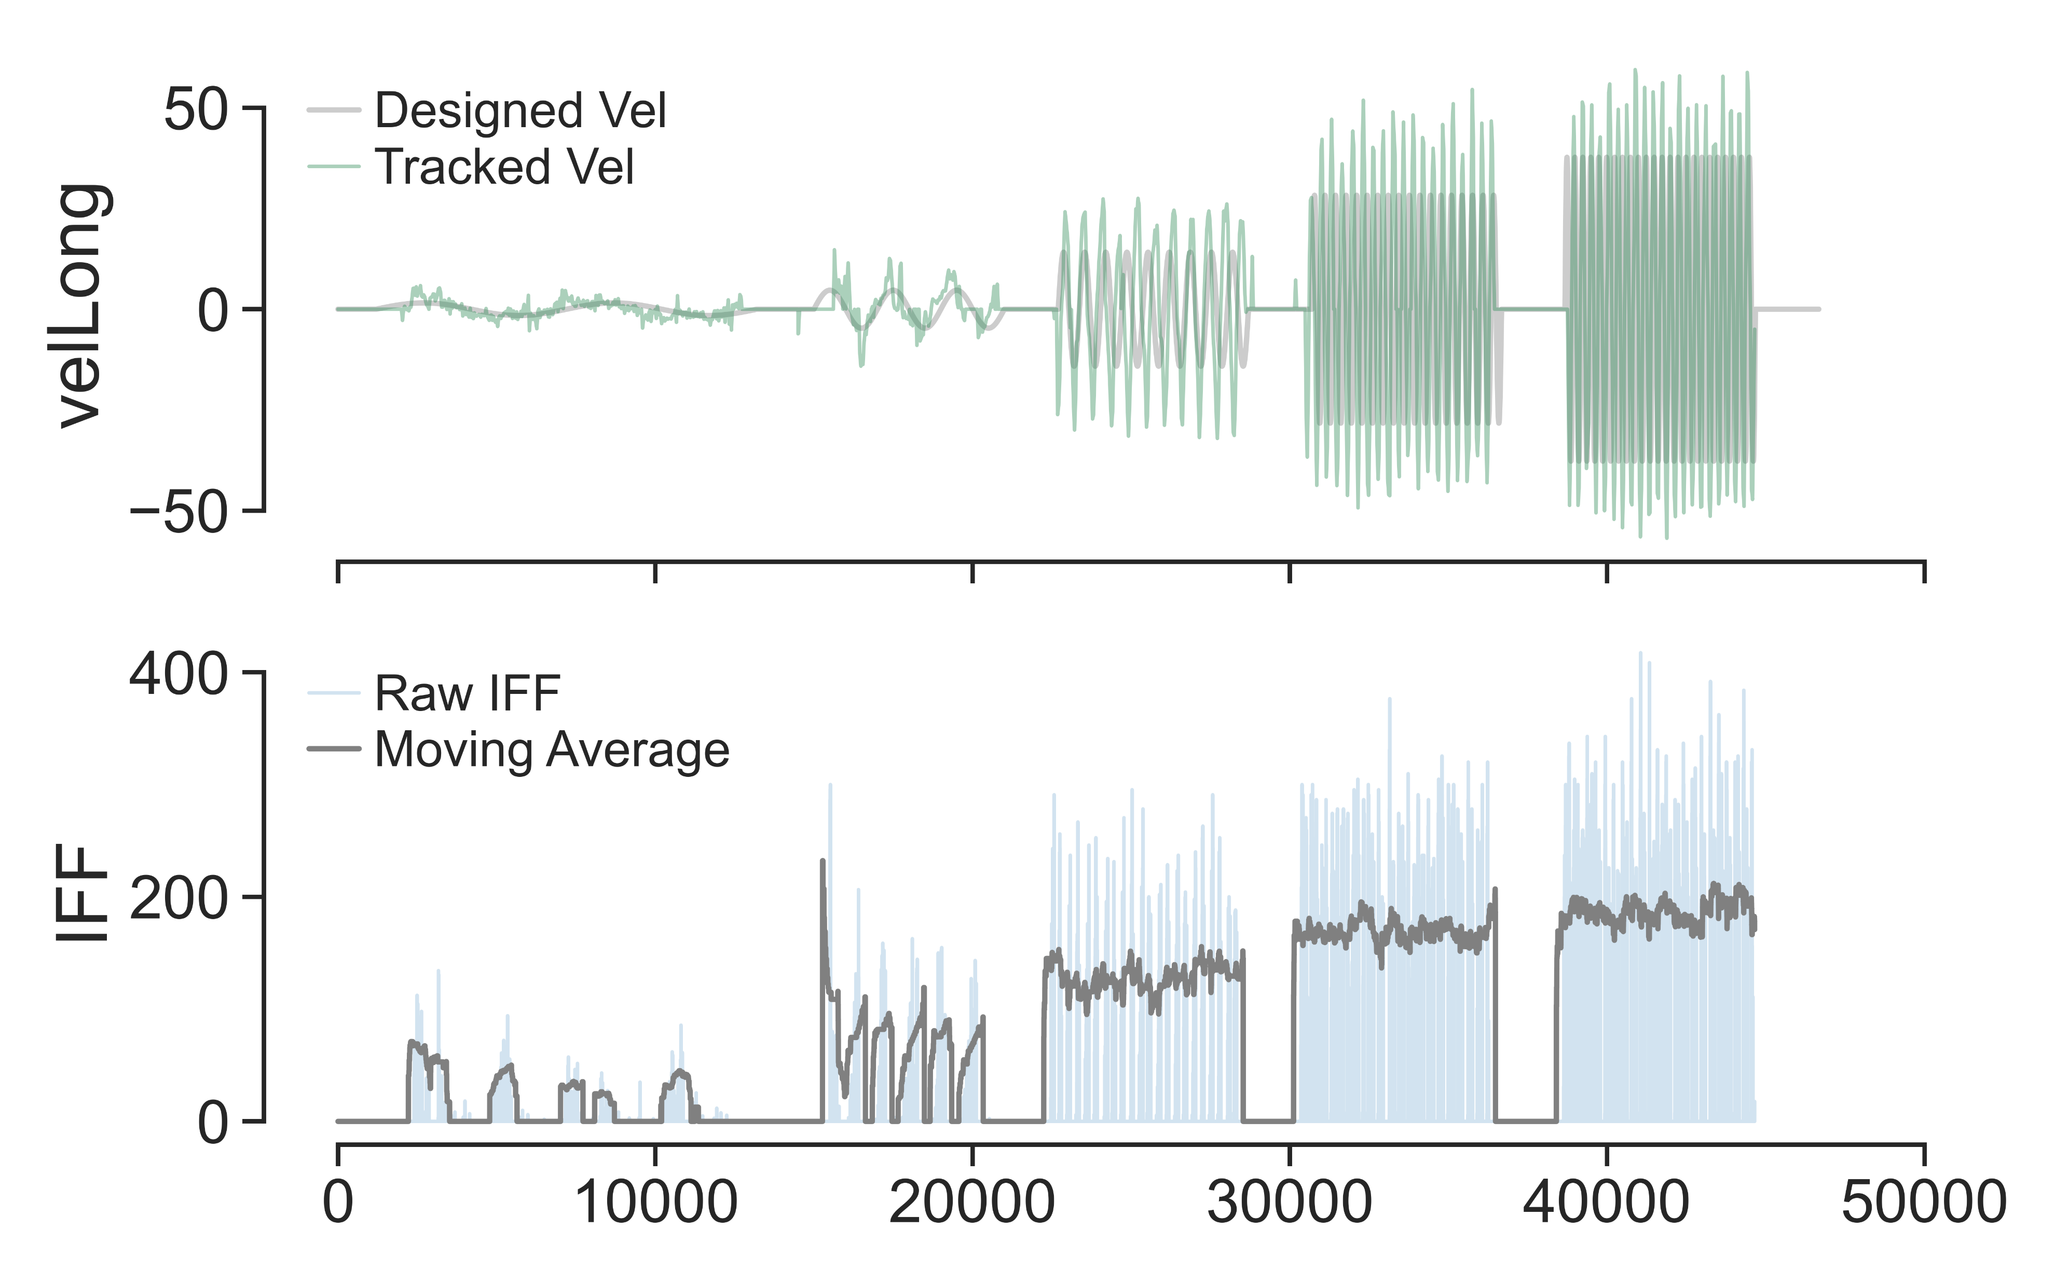
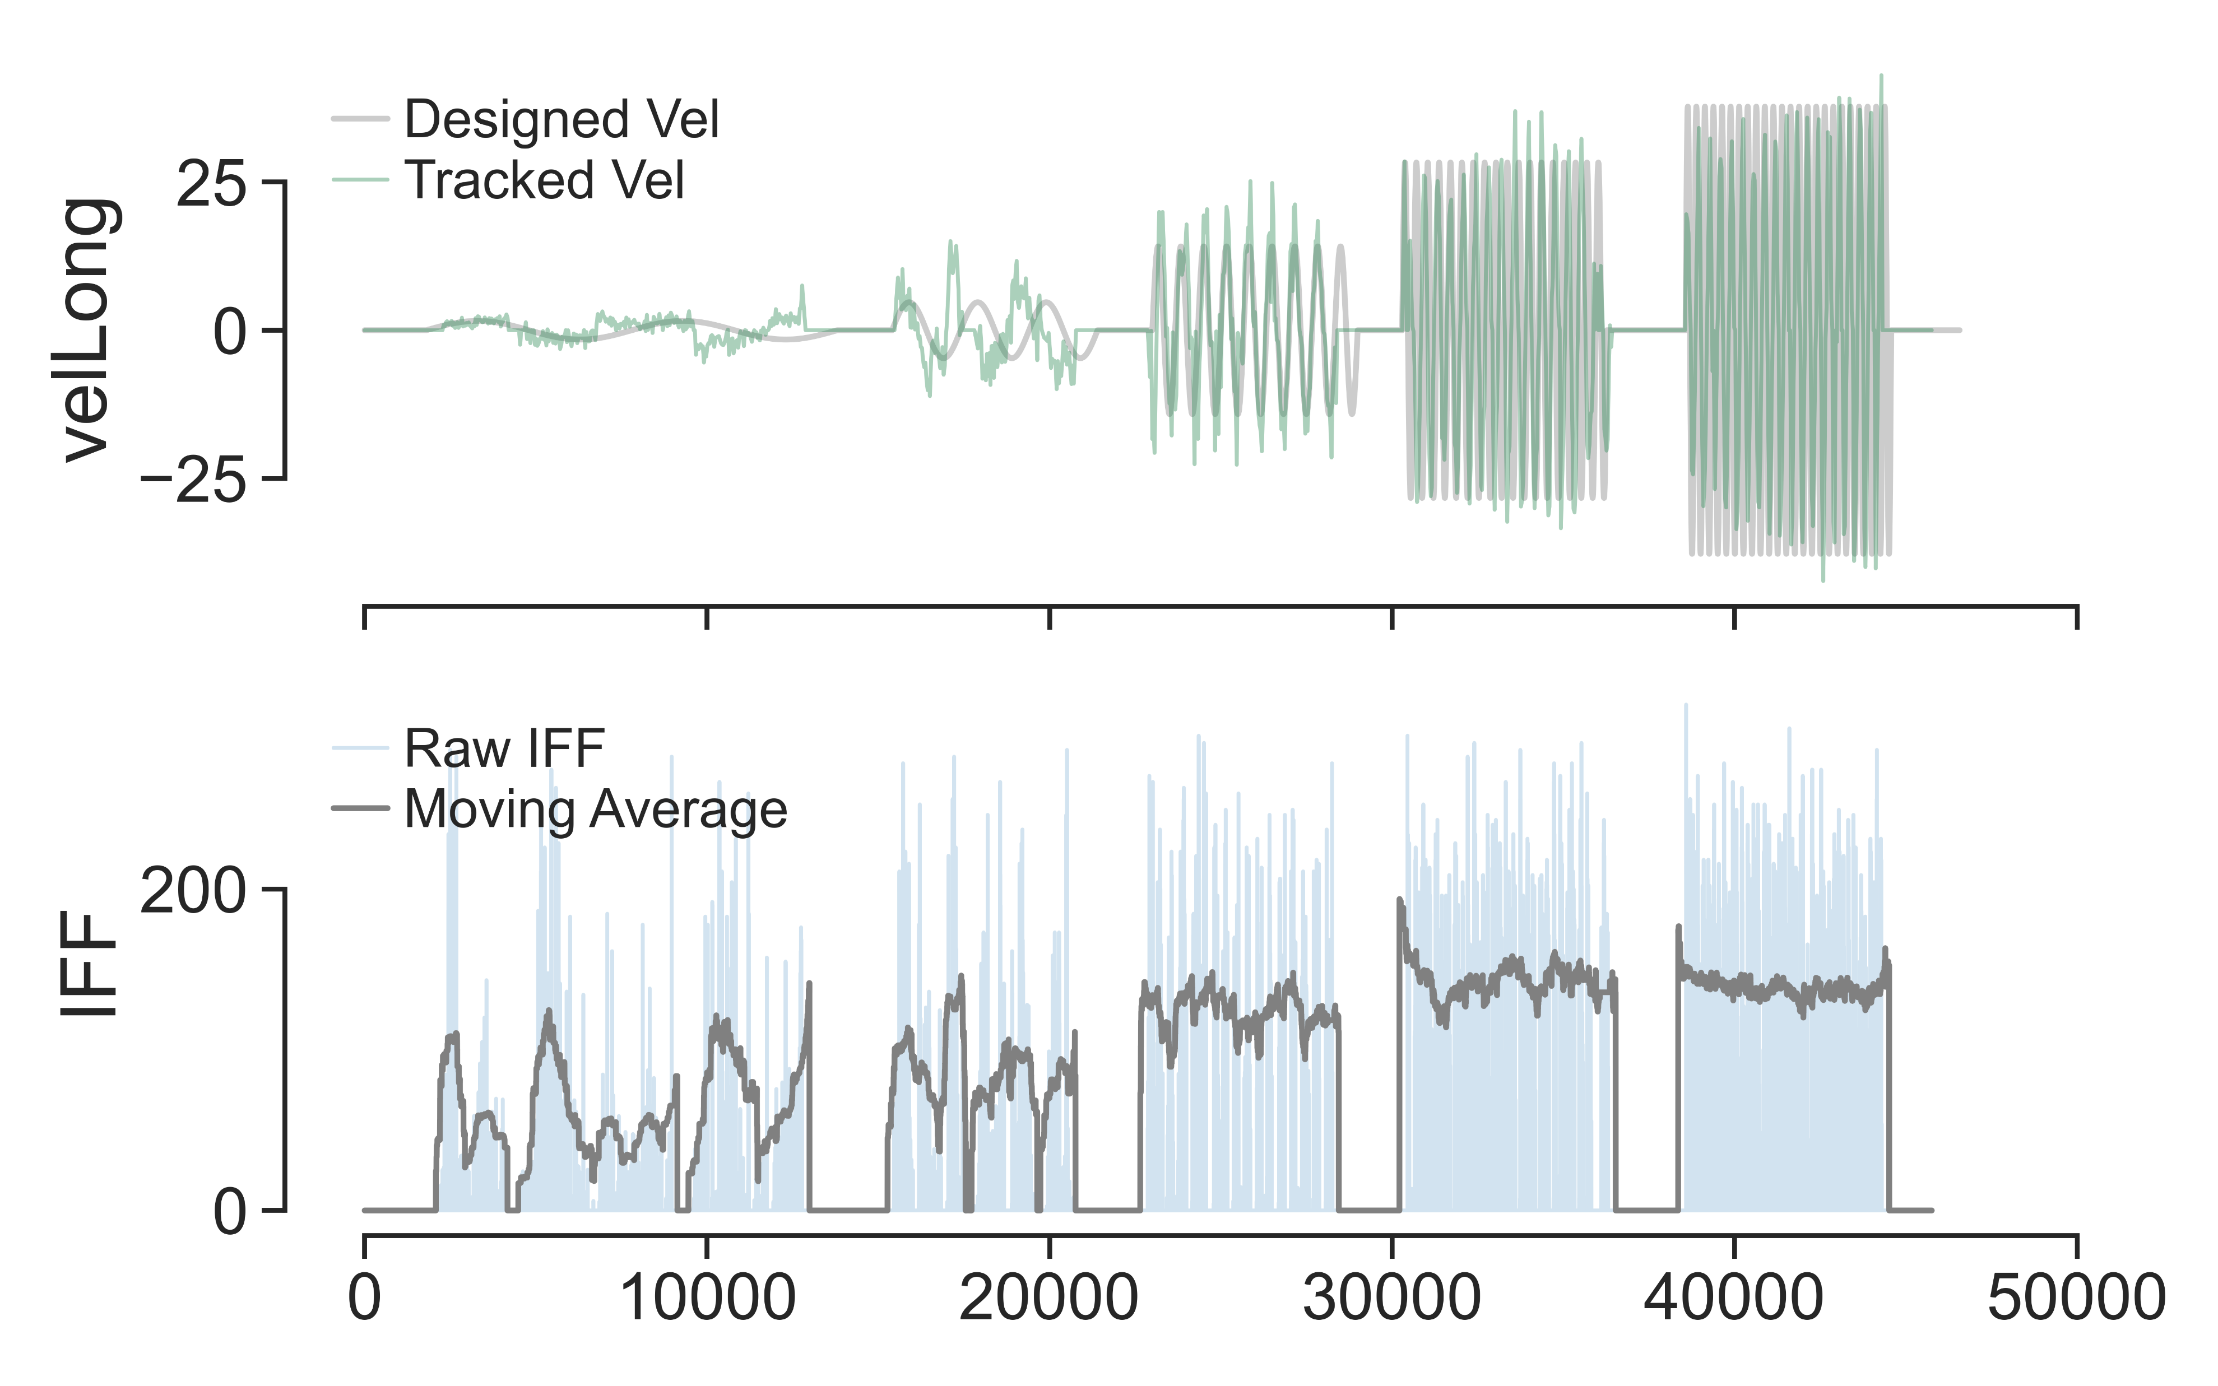
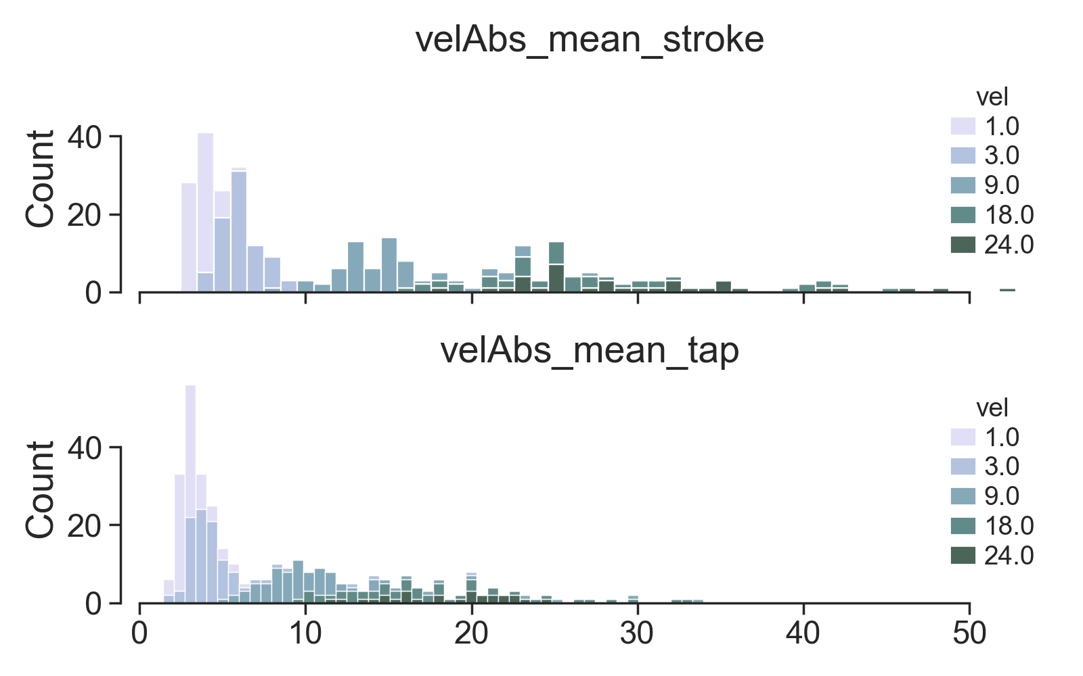
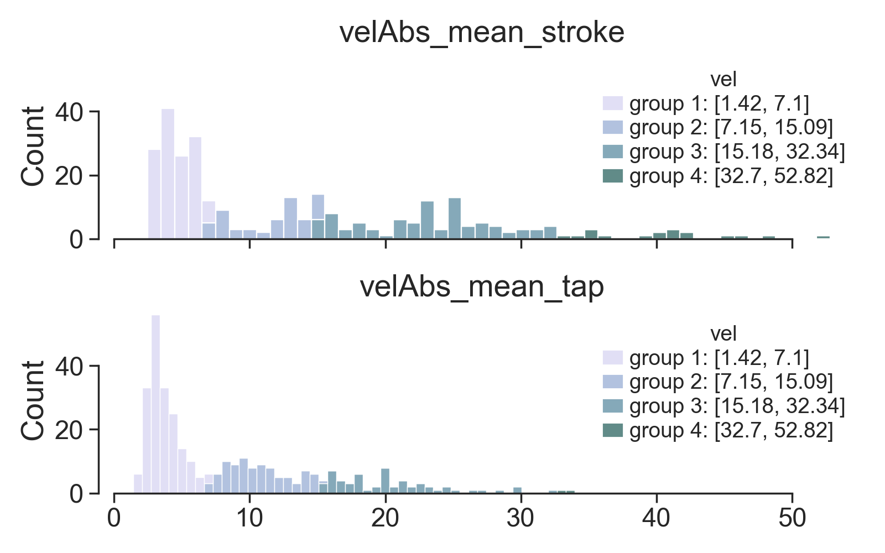
SAI
HFA

Slide 2
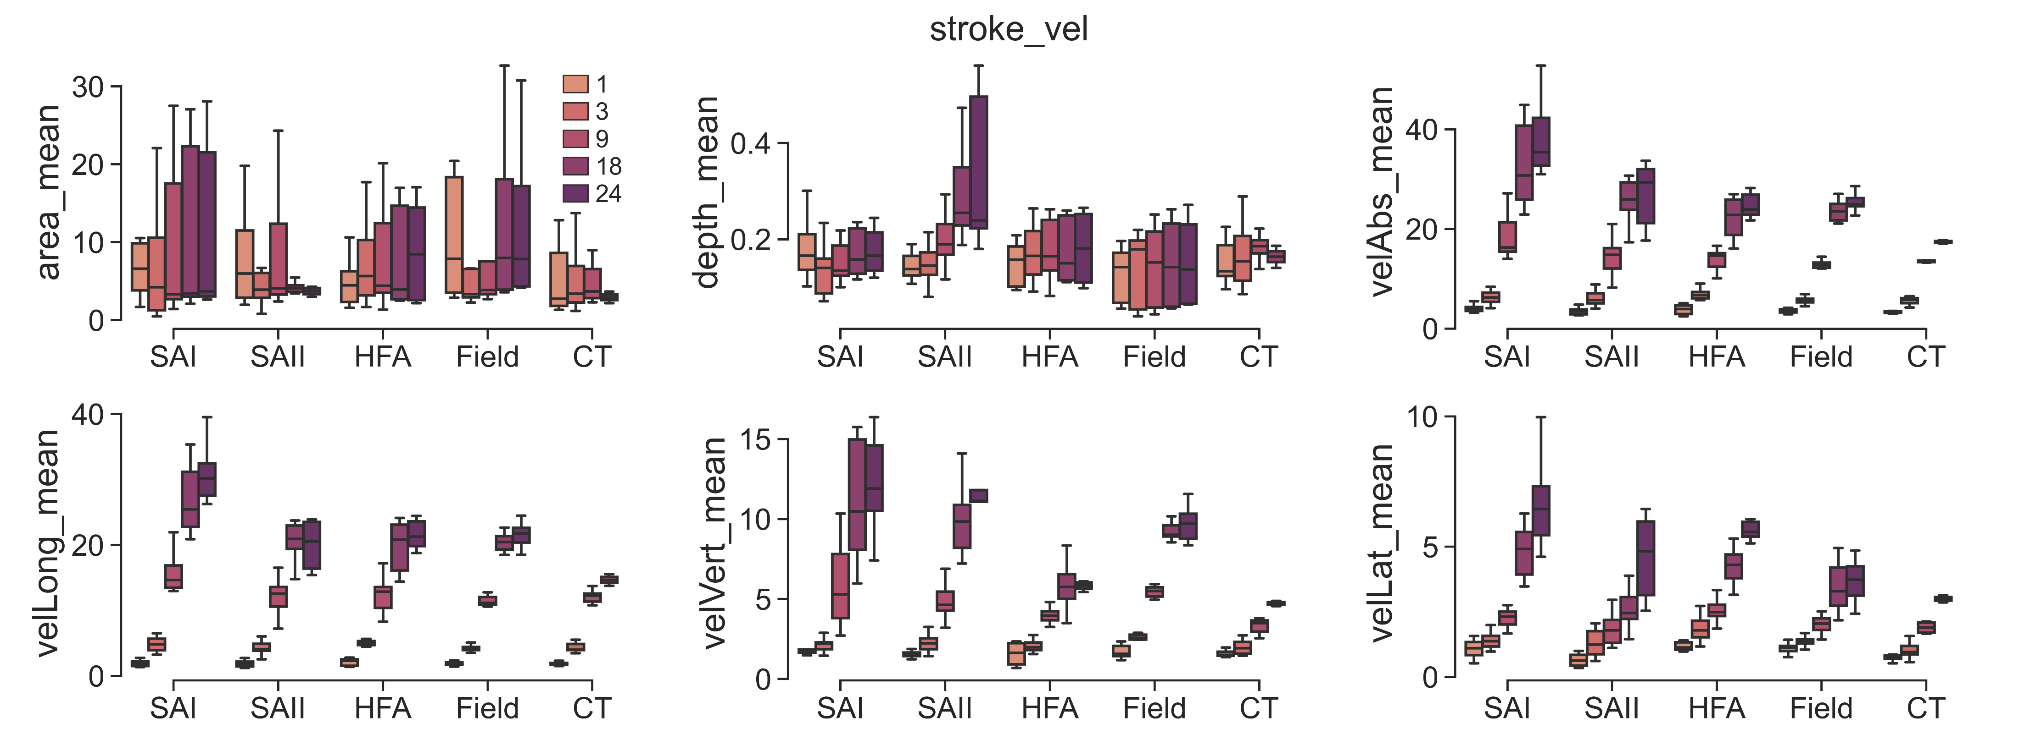
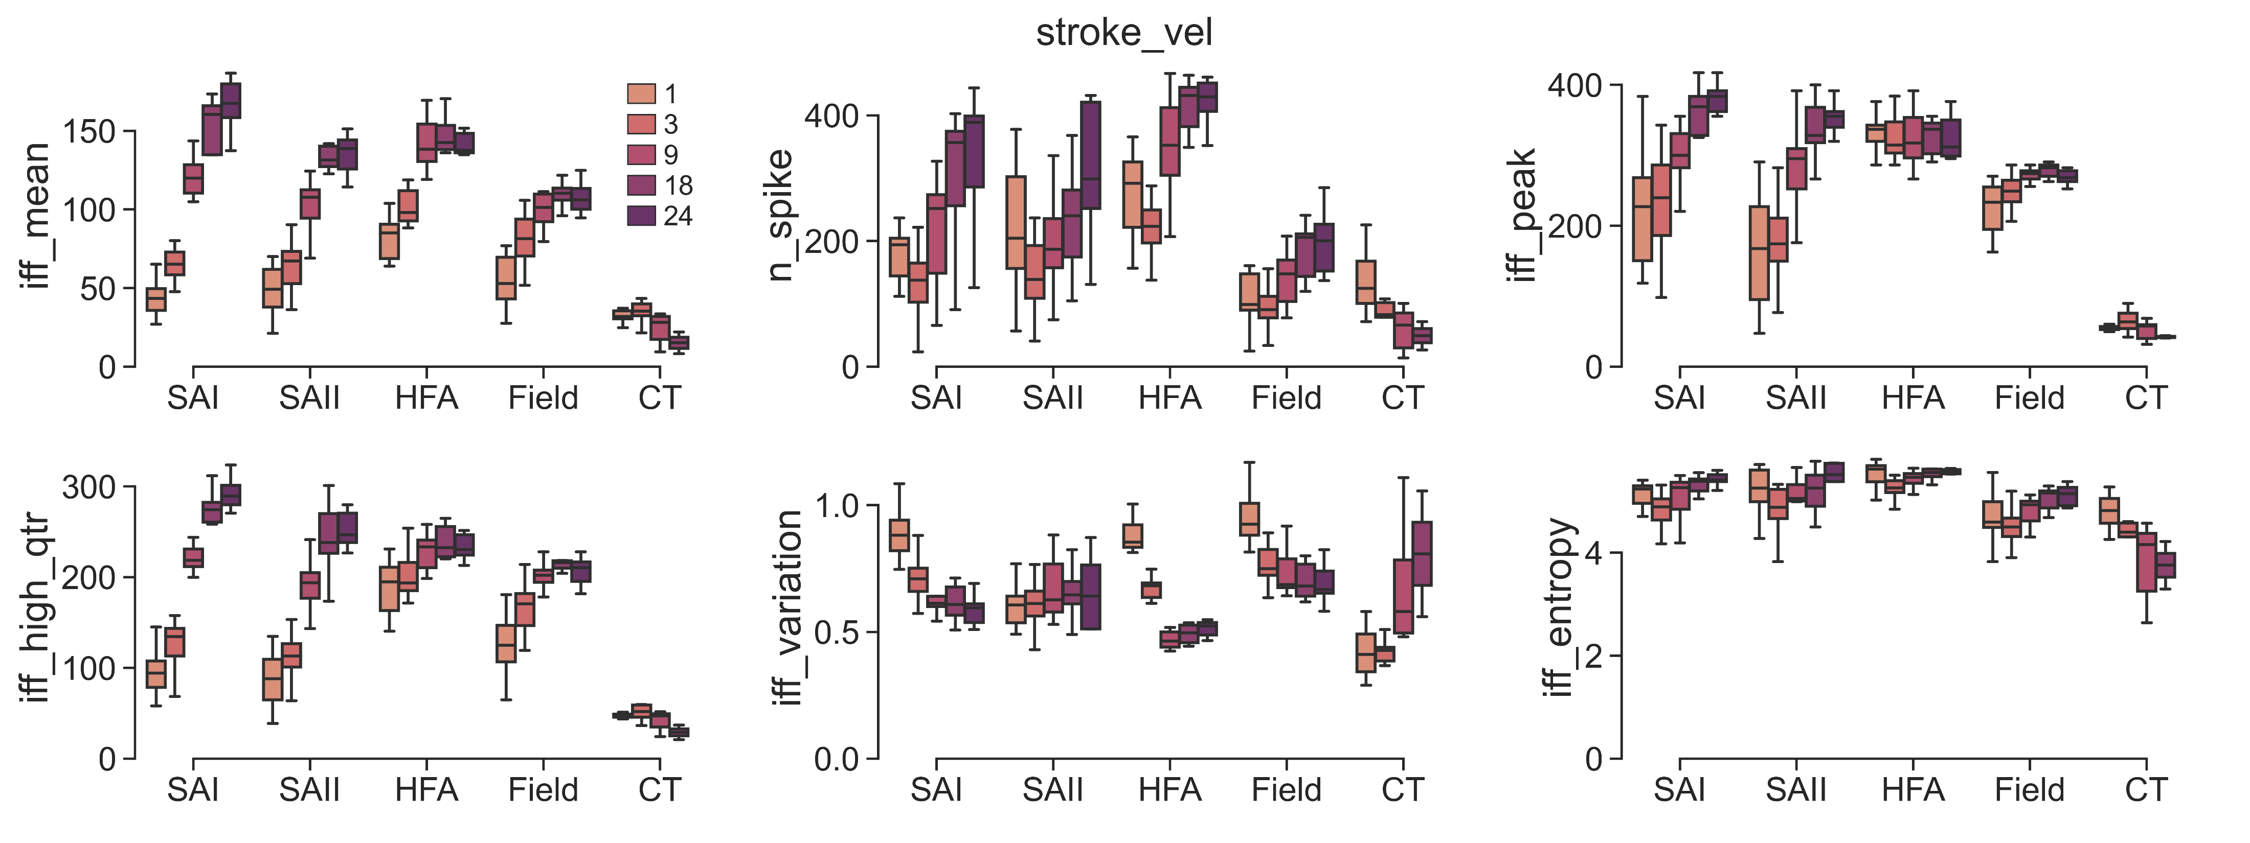
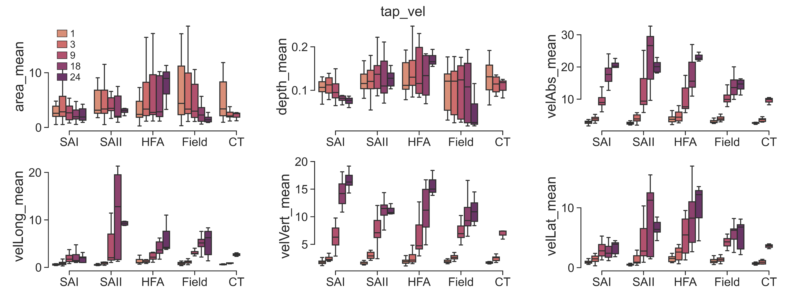
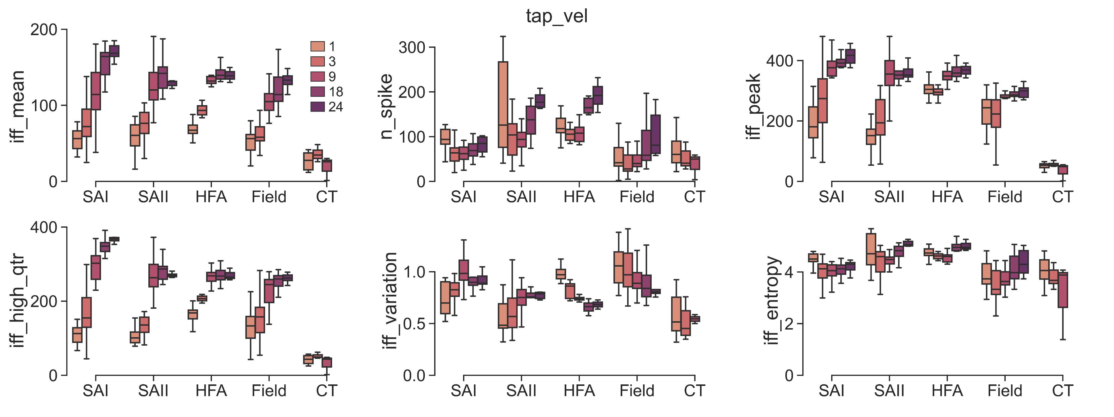
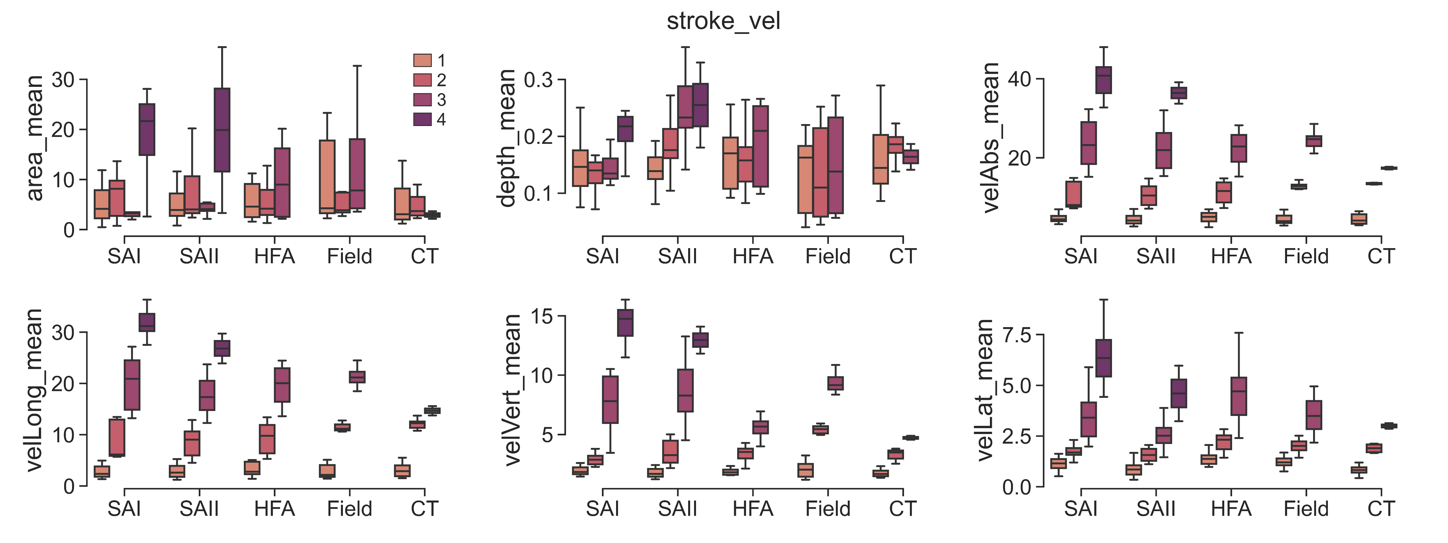
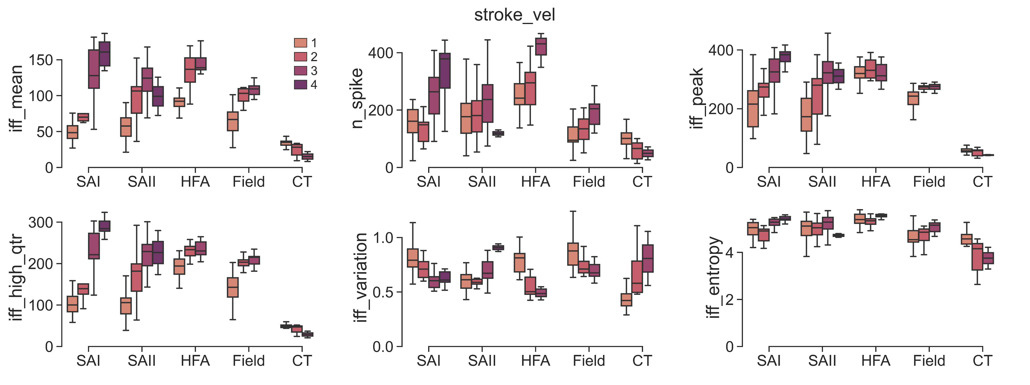
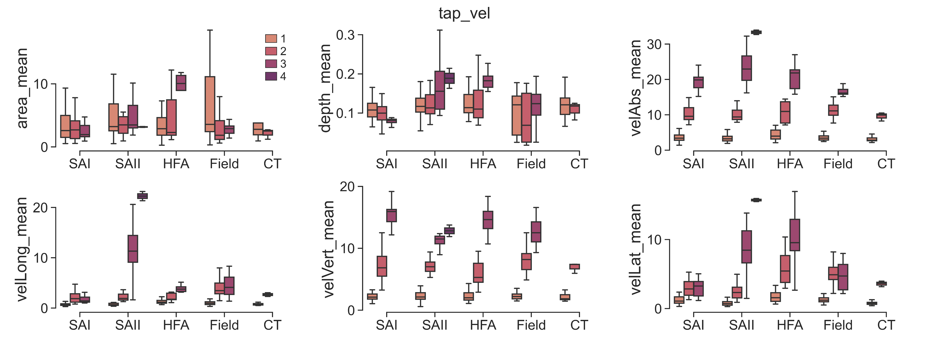
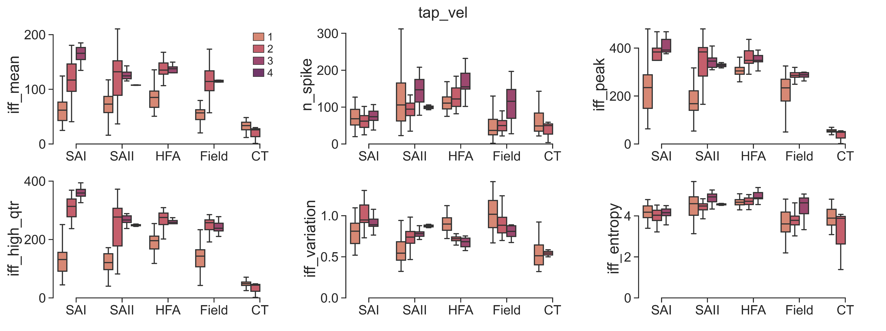
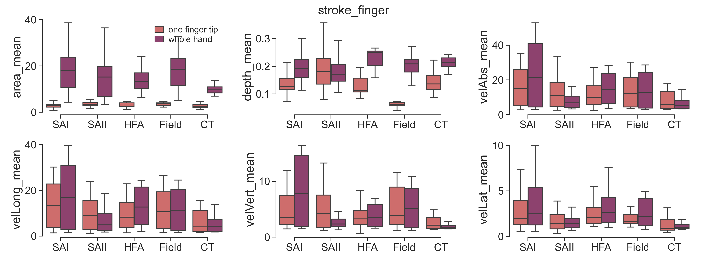
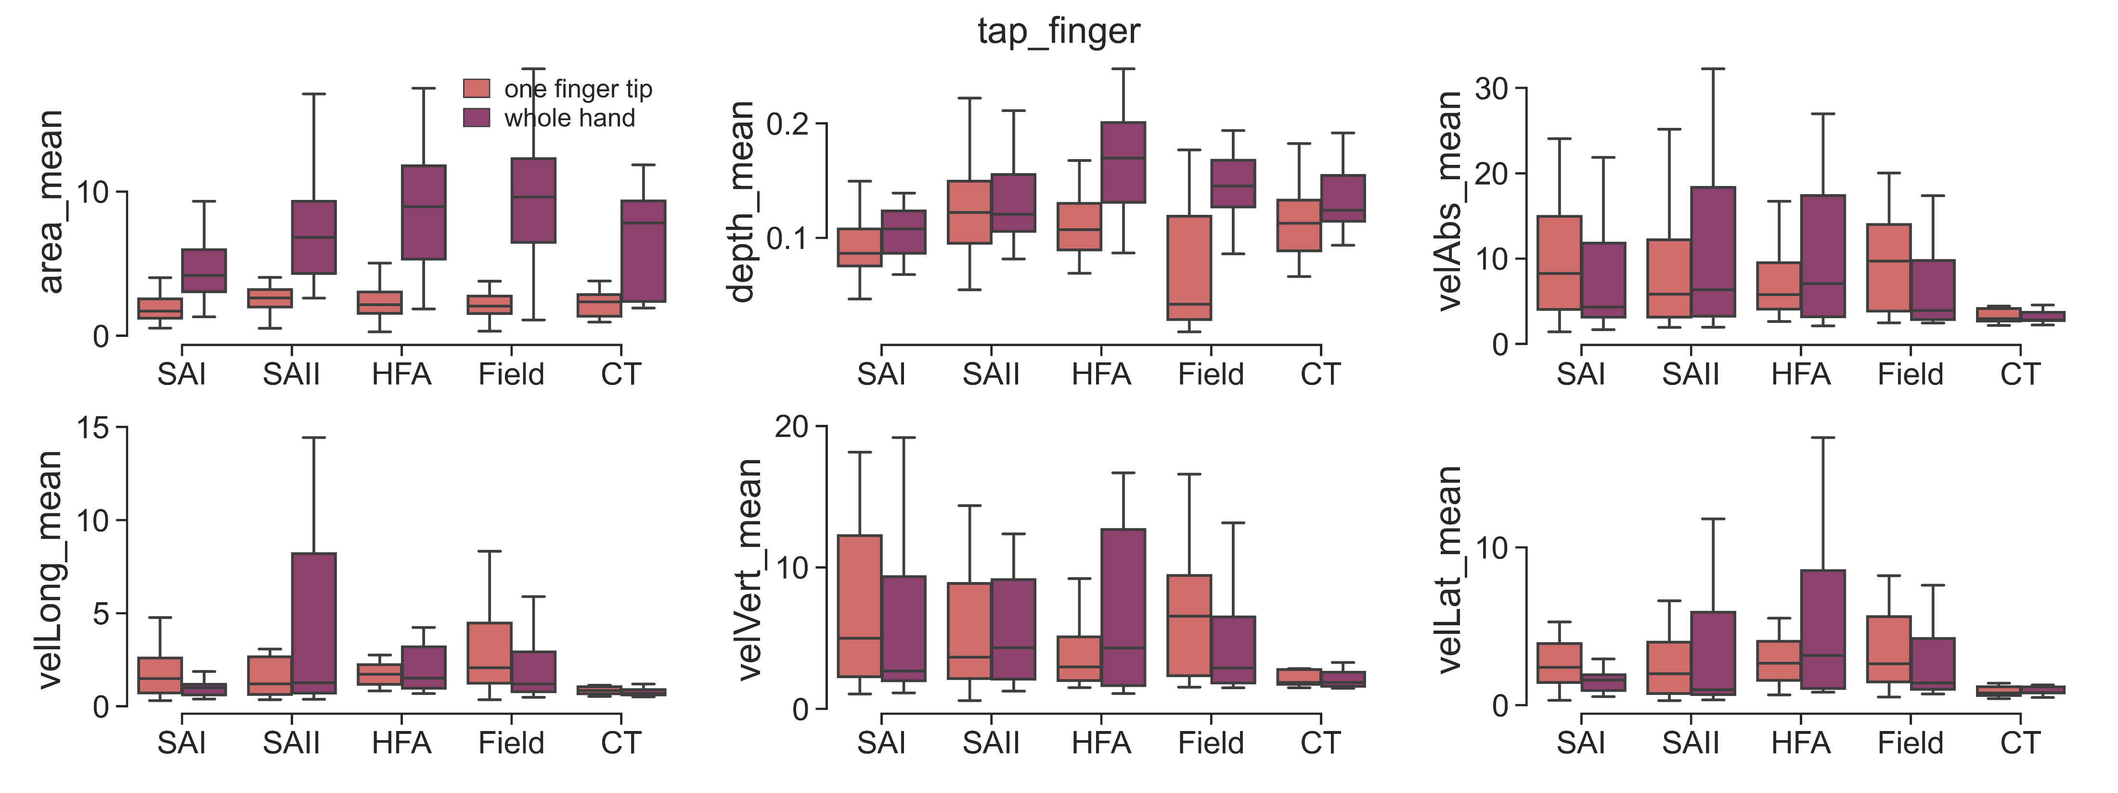
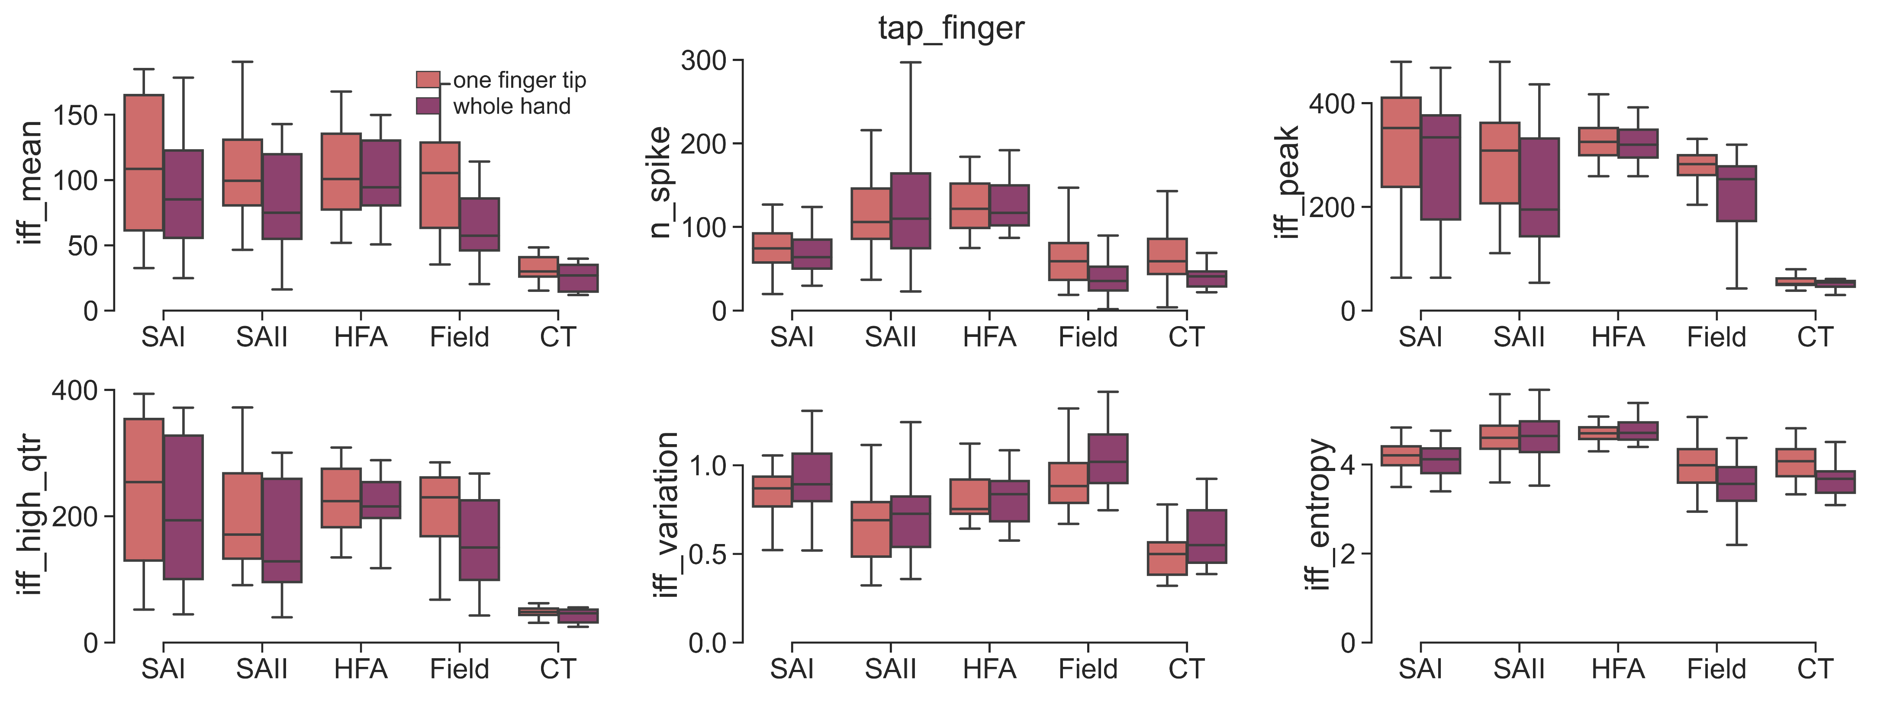

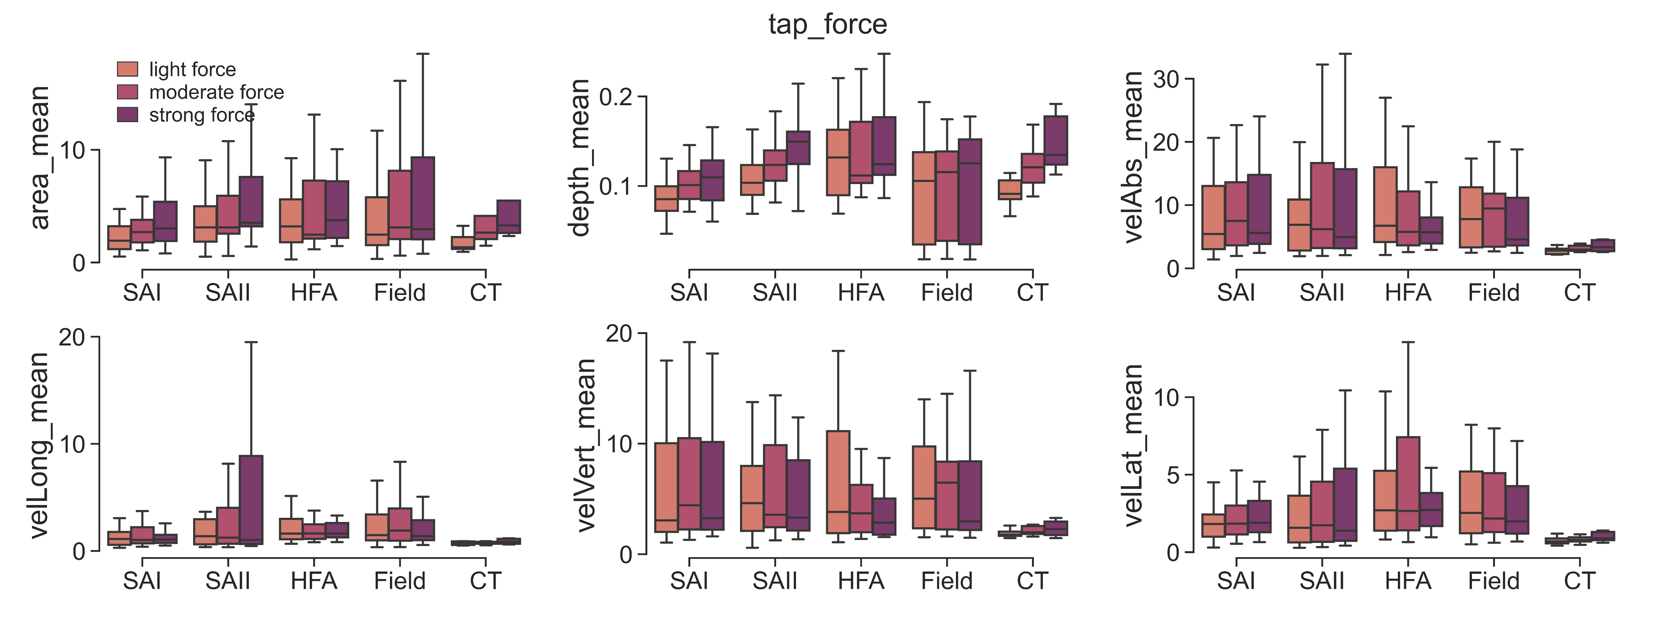
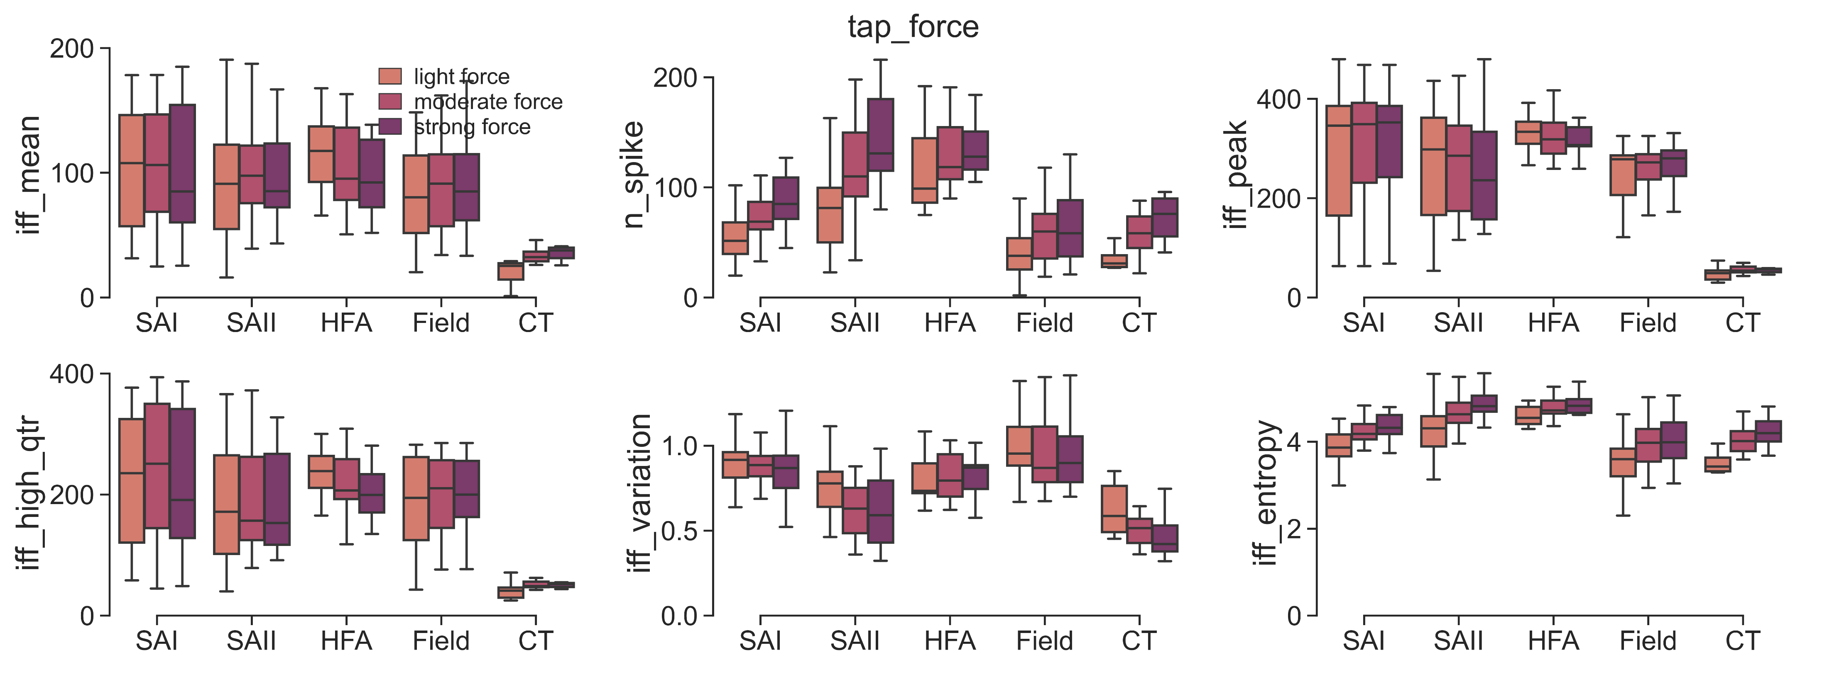
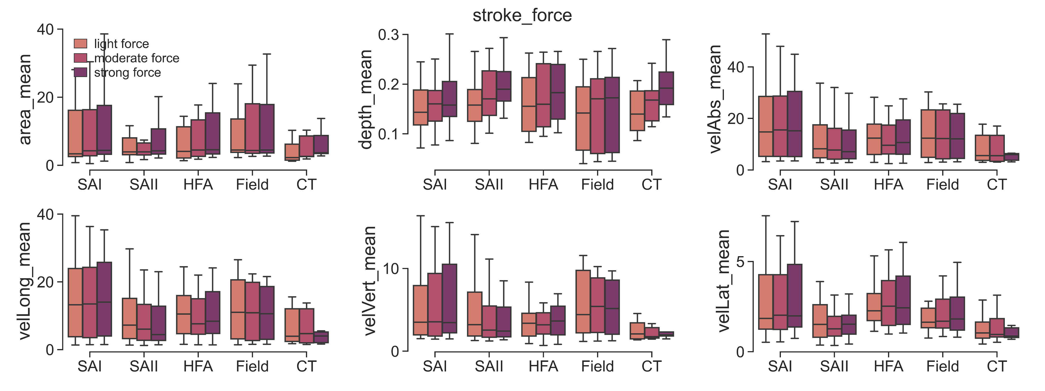
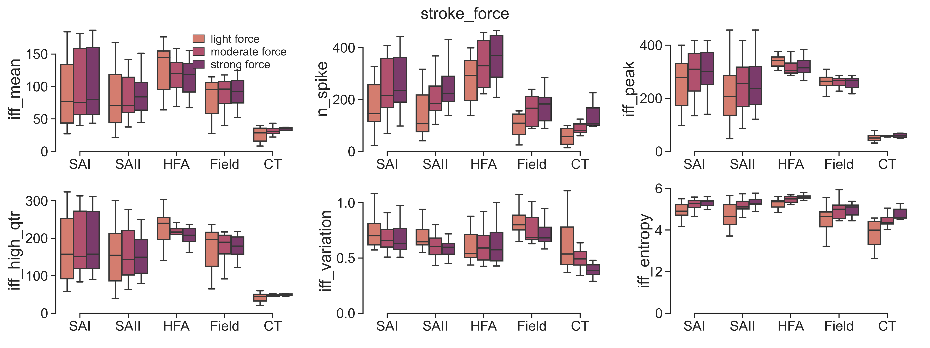
Stroking
Tapping

Slide 3
'2022-06-17/unit2/’:SAII -2.8{(0,1,2,3):0, (4,5,6,7):0.3, (8,9,10,11):0.7, (12,13,14,15):1.2}
'2022-06-17/unit5/’:SAI -2.7 {(0,1,2,3):0, (4,5,6,7):0.3, (8,9,10,11):0.7, (12,13,14,15):1.2}
'2022-06-22/unit1/’:Field -2.7{(0,1,2,3):0, (4,5,6,7):0.6, (8,9,10,11):0.9, (12,13,14,15):1.2}
'2022-06-14/unit1/’:SAII -2.8 {(0,1,2,3):0}
'2022-06-14/unit3/’:HFA -2.9{(0,1):0, (2,3):0.5, (4,5):0.3, (6,7,8,9):0.9}
'2022-06-14/unit2/’:CT -2{(0,1,2,3):0, (4,5,6,7):0.3}
'2022-06-15/unit1/’:SAI -2.7 {(0,1):0, (2,2):-0.3, (3,4,5,6):0.3, (7,8):0.8}
'2022-06-15/unit2/’:HFA -2.8{(0,1,2,3):0, (4,5):0.3}
'2022-06-15/unit3/' '2022-06-16/unit2/’: SAII -2.7 Field -2.75{(0,1):0}
'2022-06-16/unit1/' '2022-06-17/unit4/’:Field -2.9 Field -2.8 {(0,1,2,3):0}
'2022-06-17/unit3/’: CT -2.3{(0,1):0, (2,3,4):0.3}
'2022-06-15/unit4/’: Field -2.8 {(0,0):-2.1, (1,2):0}
'2022-06-22/unit4/’:SAII -2.7{(0,1,2):0, (3,4,5,6):0.3}
'2022-06-22/unit2/’:SAI -2.6 {(0,0):0, (1,2):-0.2}

Slide 4
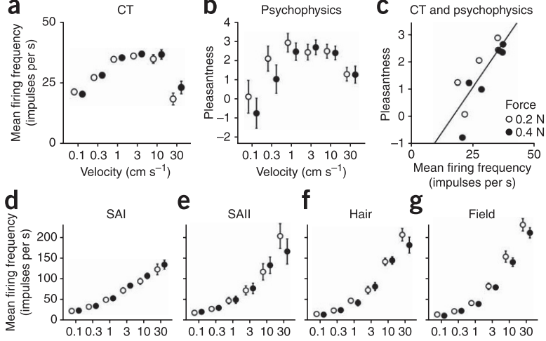
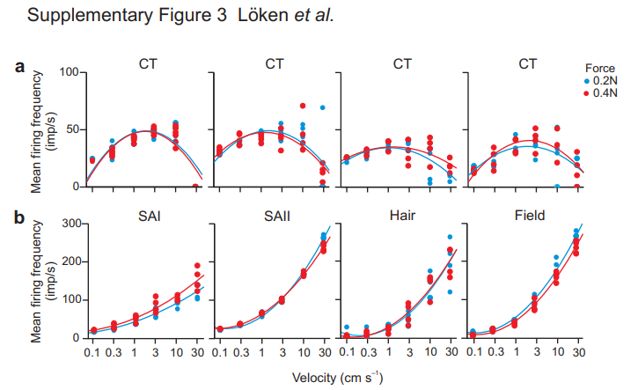
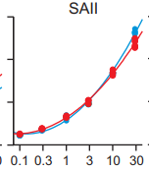
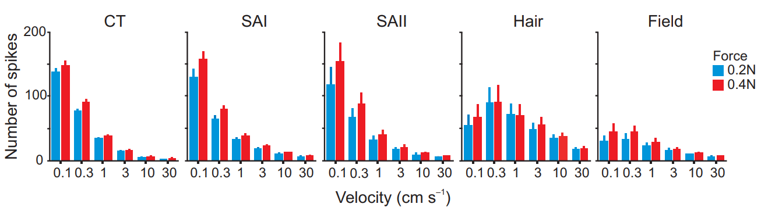
Coding of pleasant touch by unmyelinated afferents in humans

Slide 5
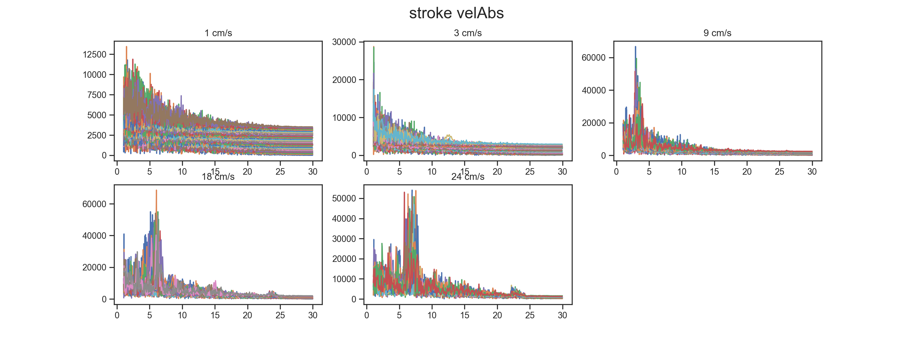
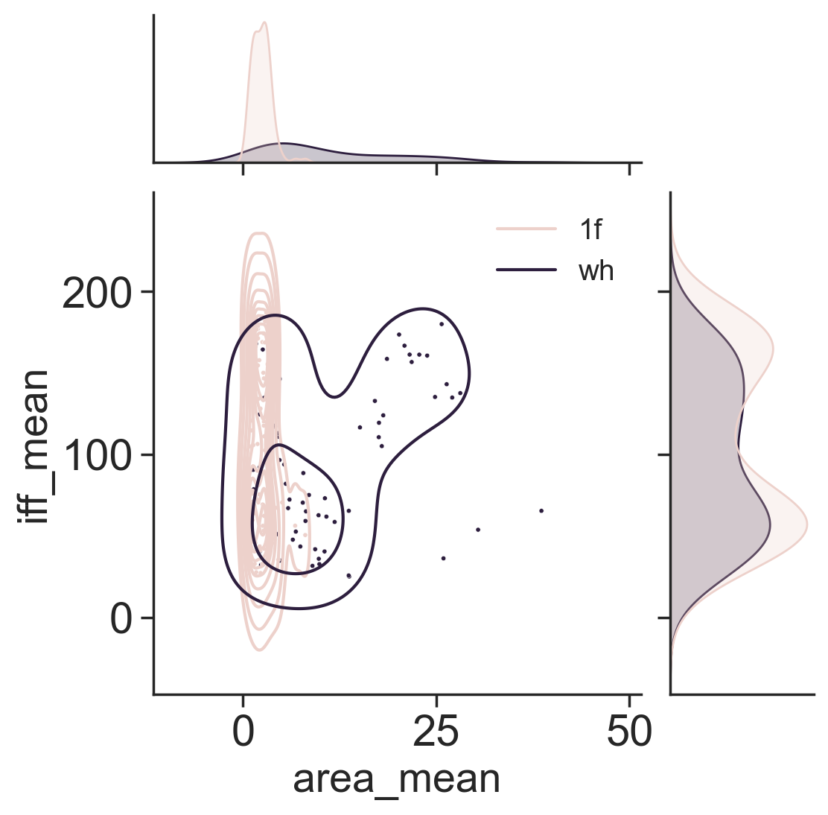
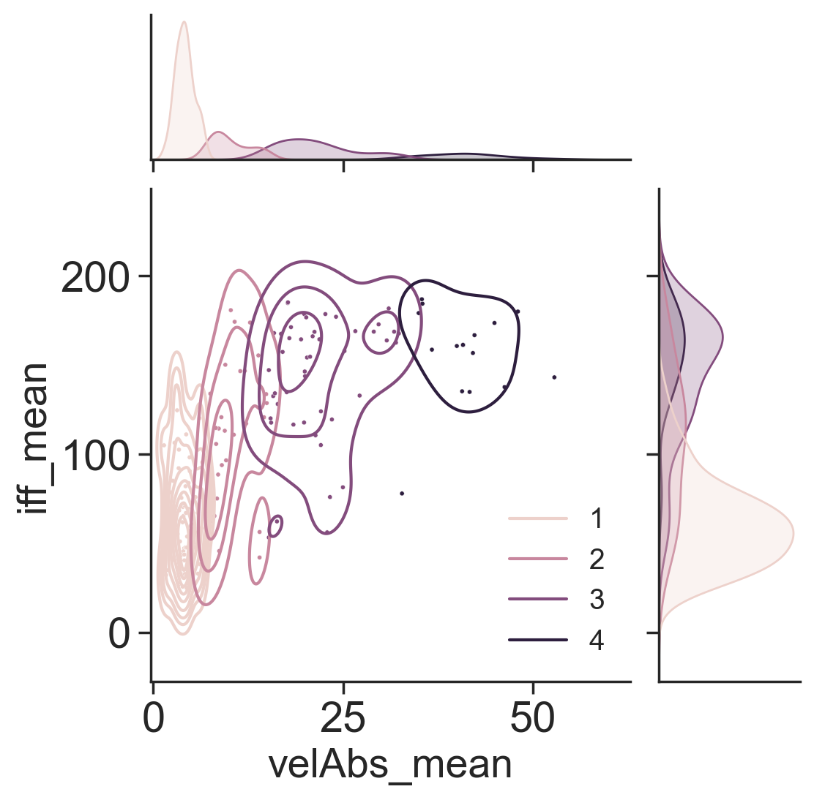
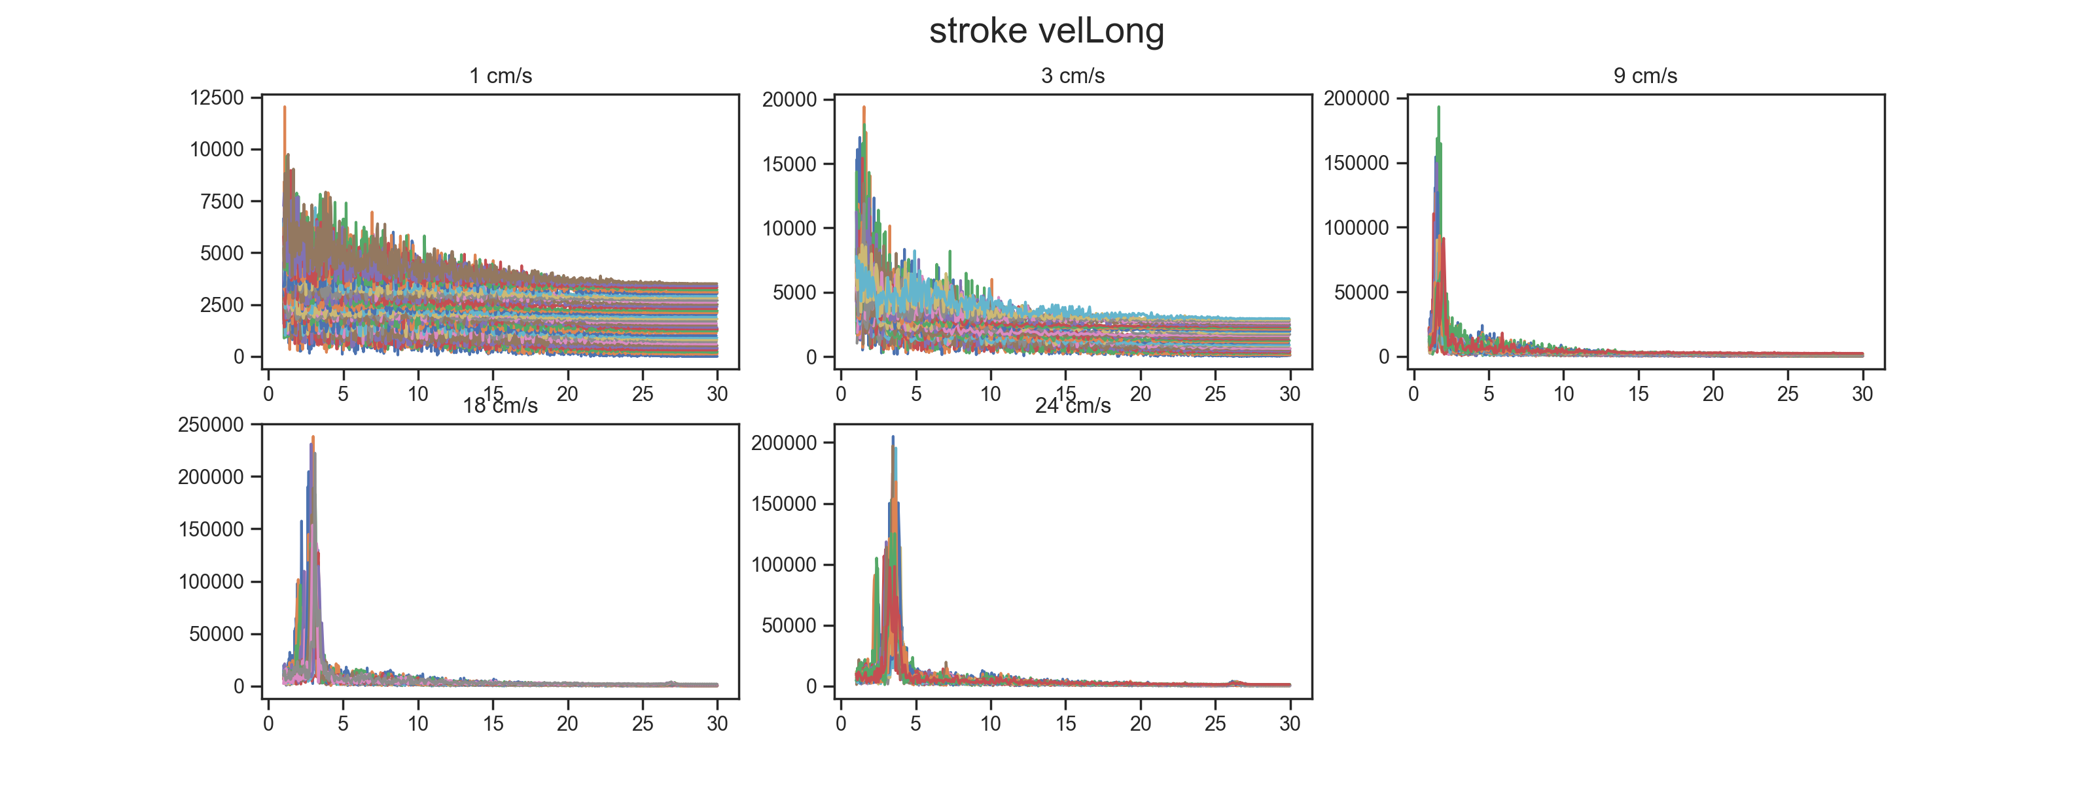
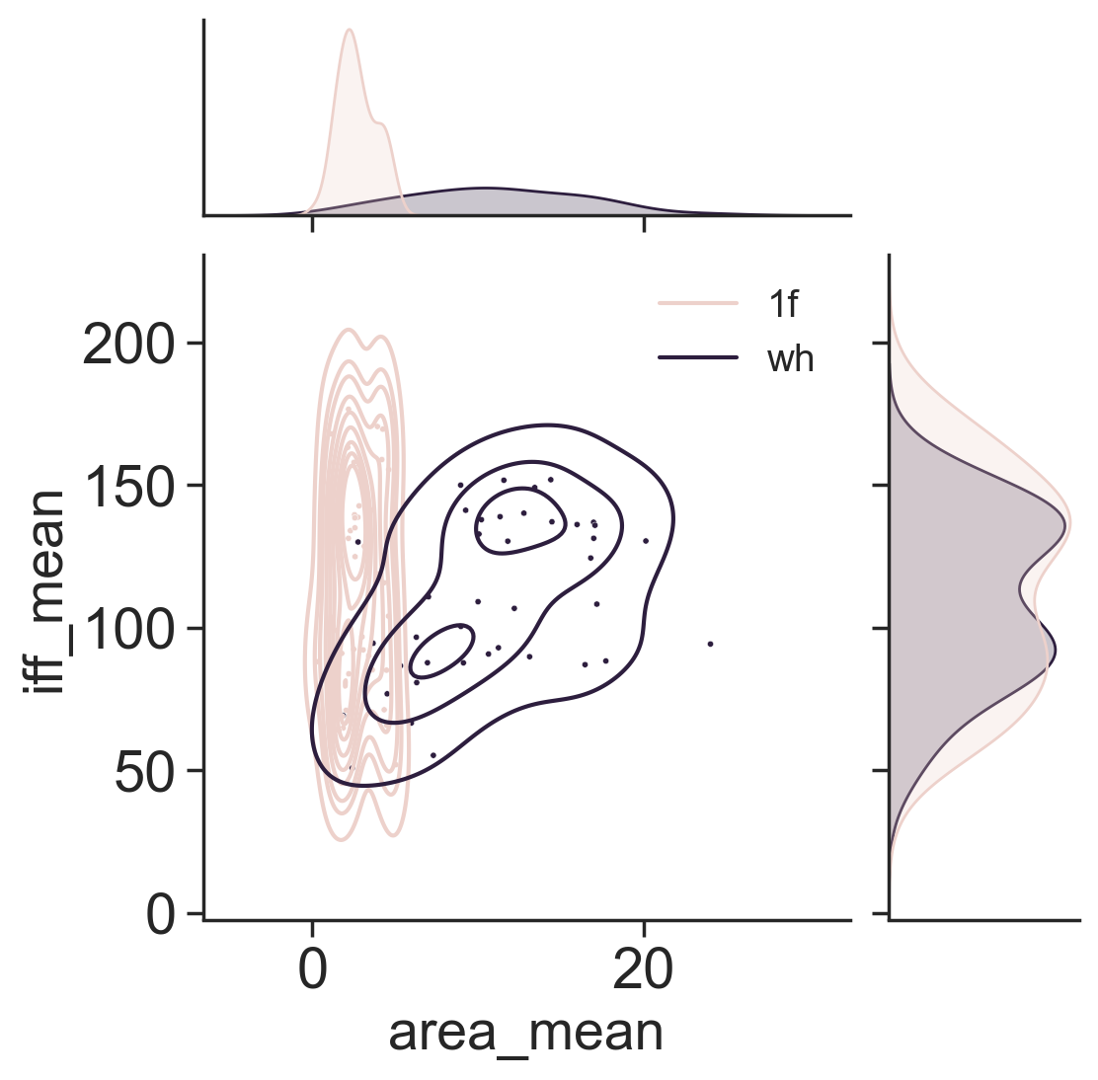
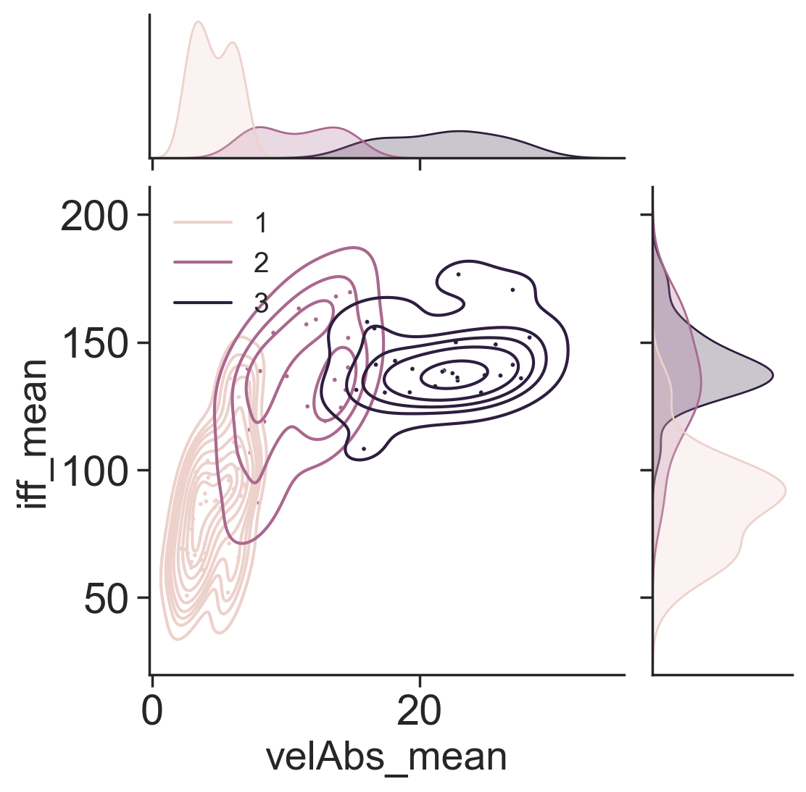
SAI
HFA

Slide 6
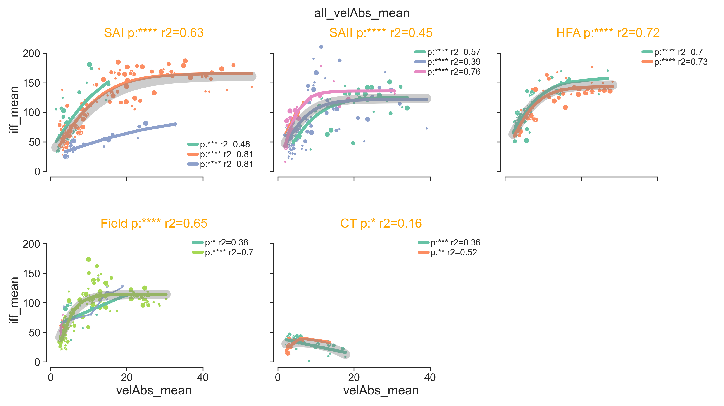

Slide 7
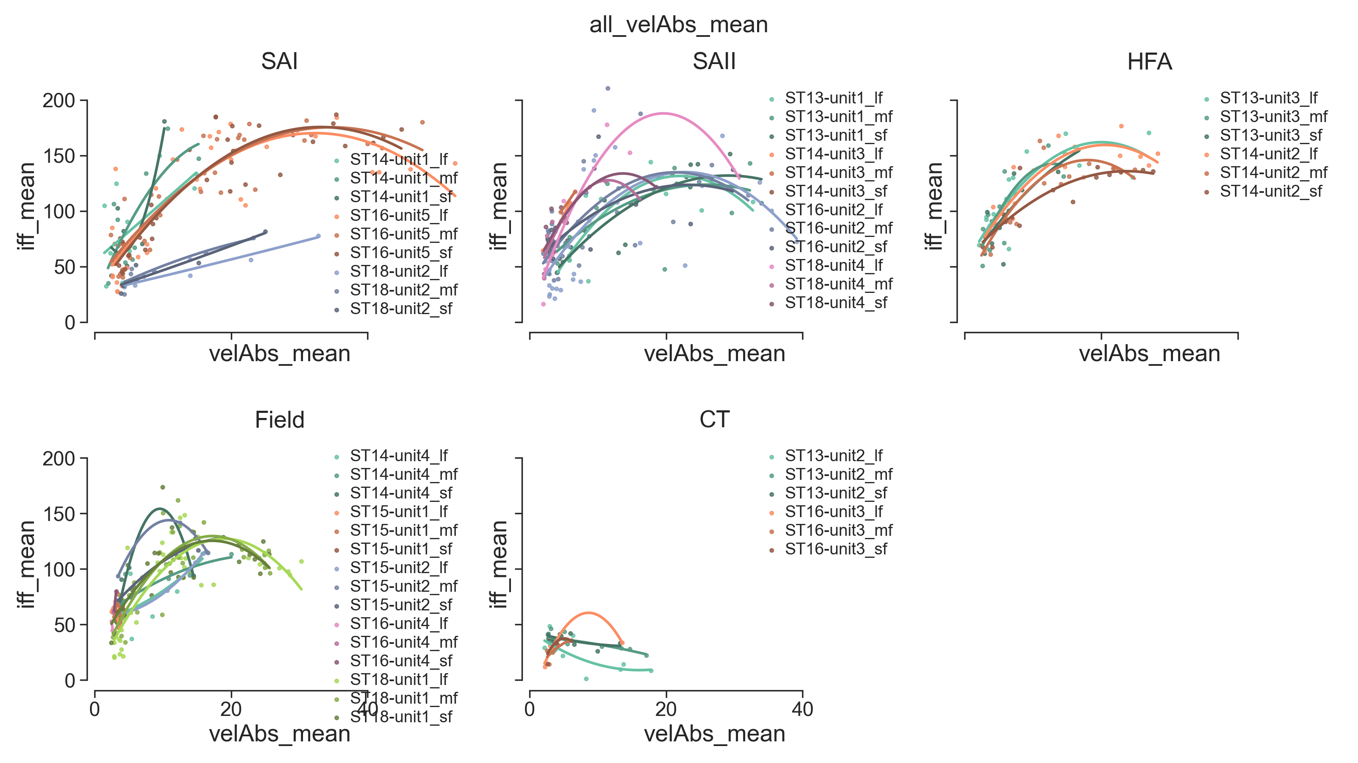

Slide 8
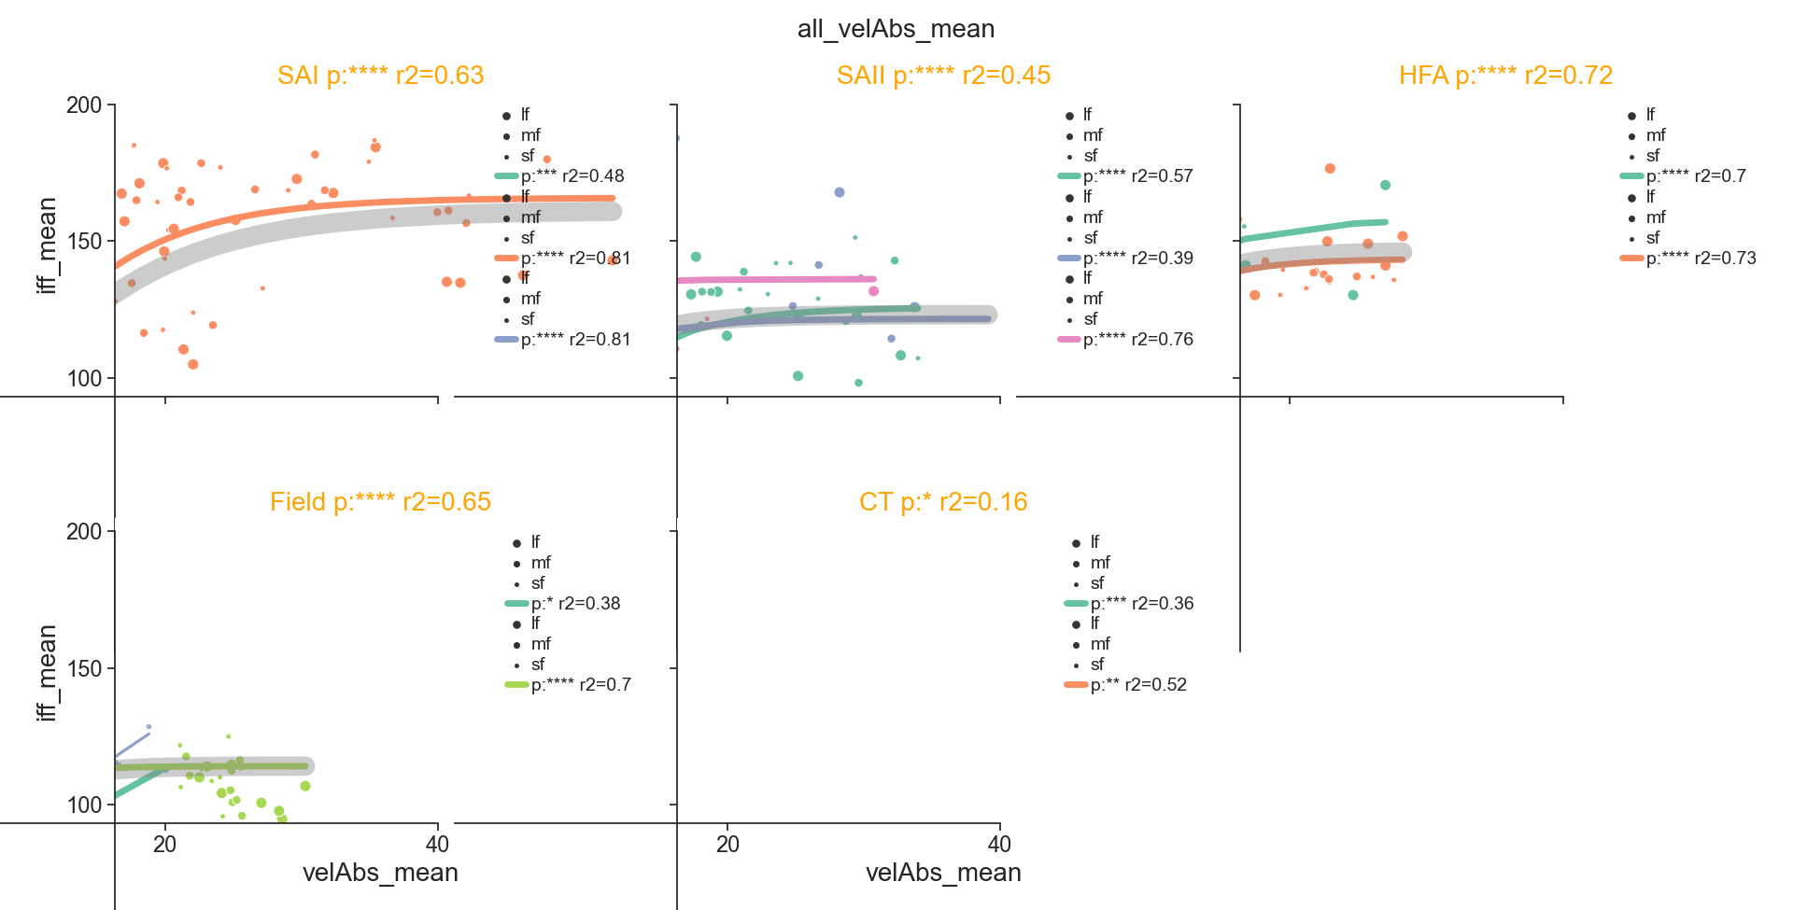

Slide 9
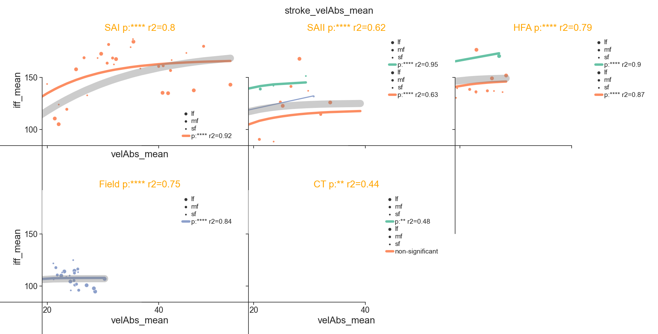

Slide 10
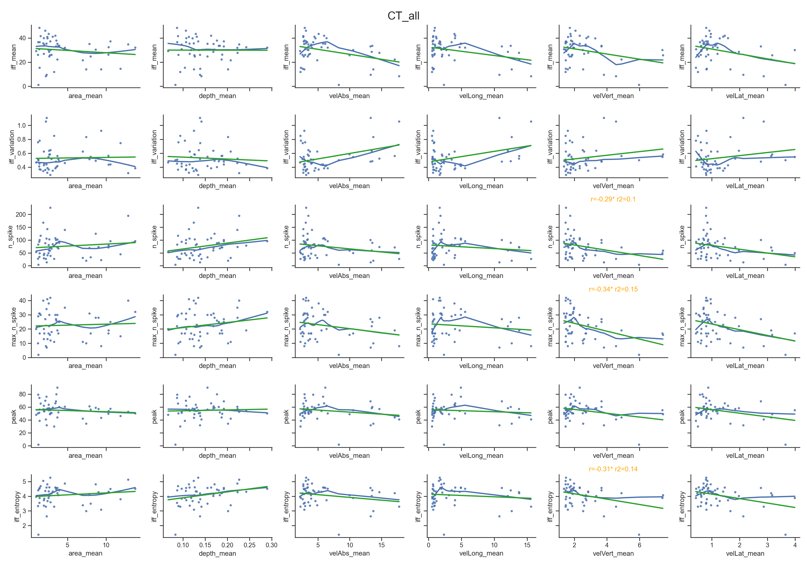
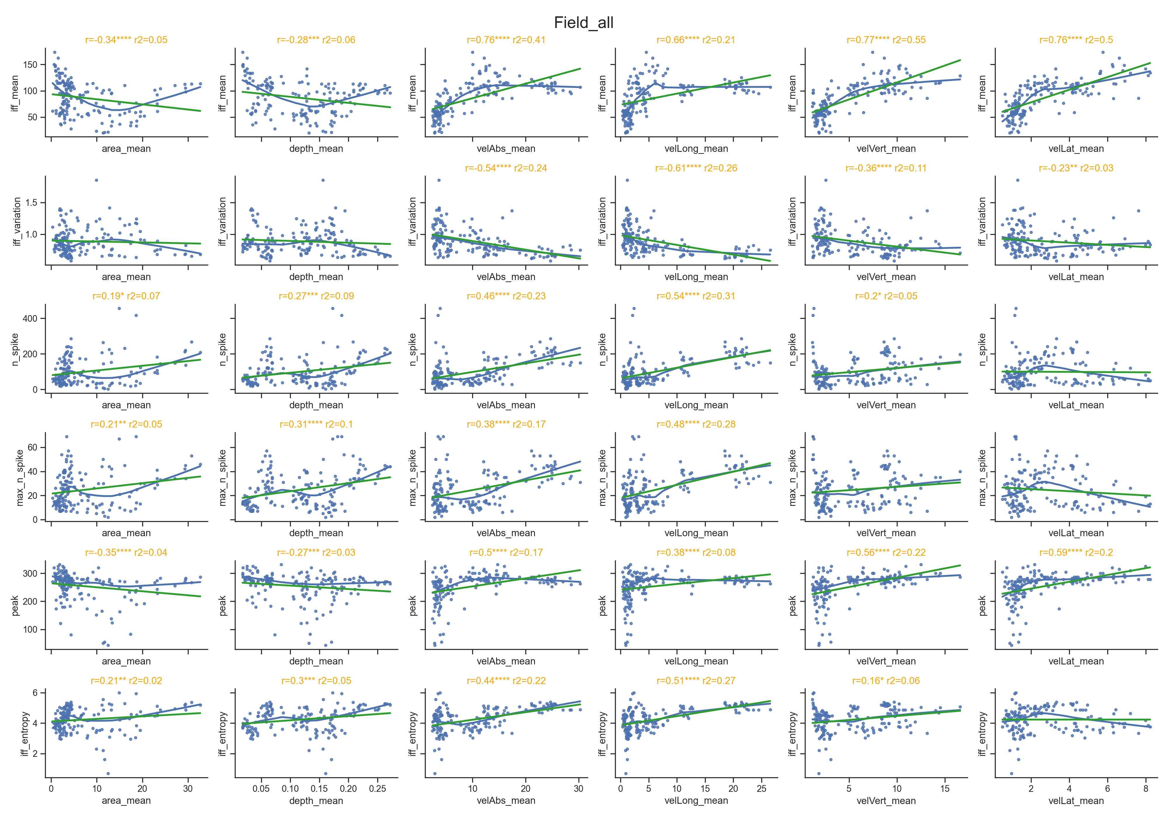
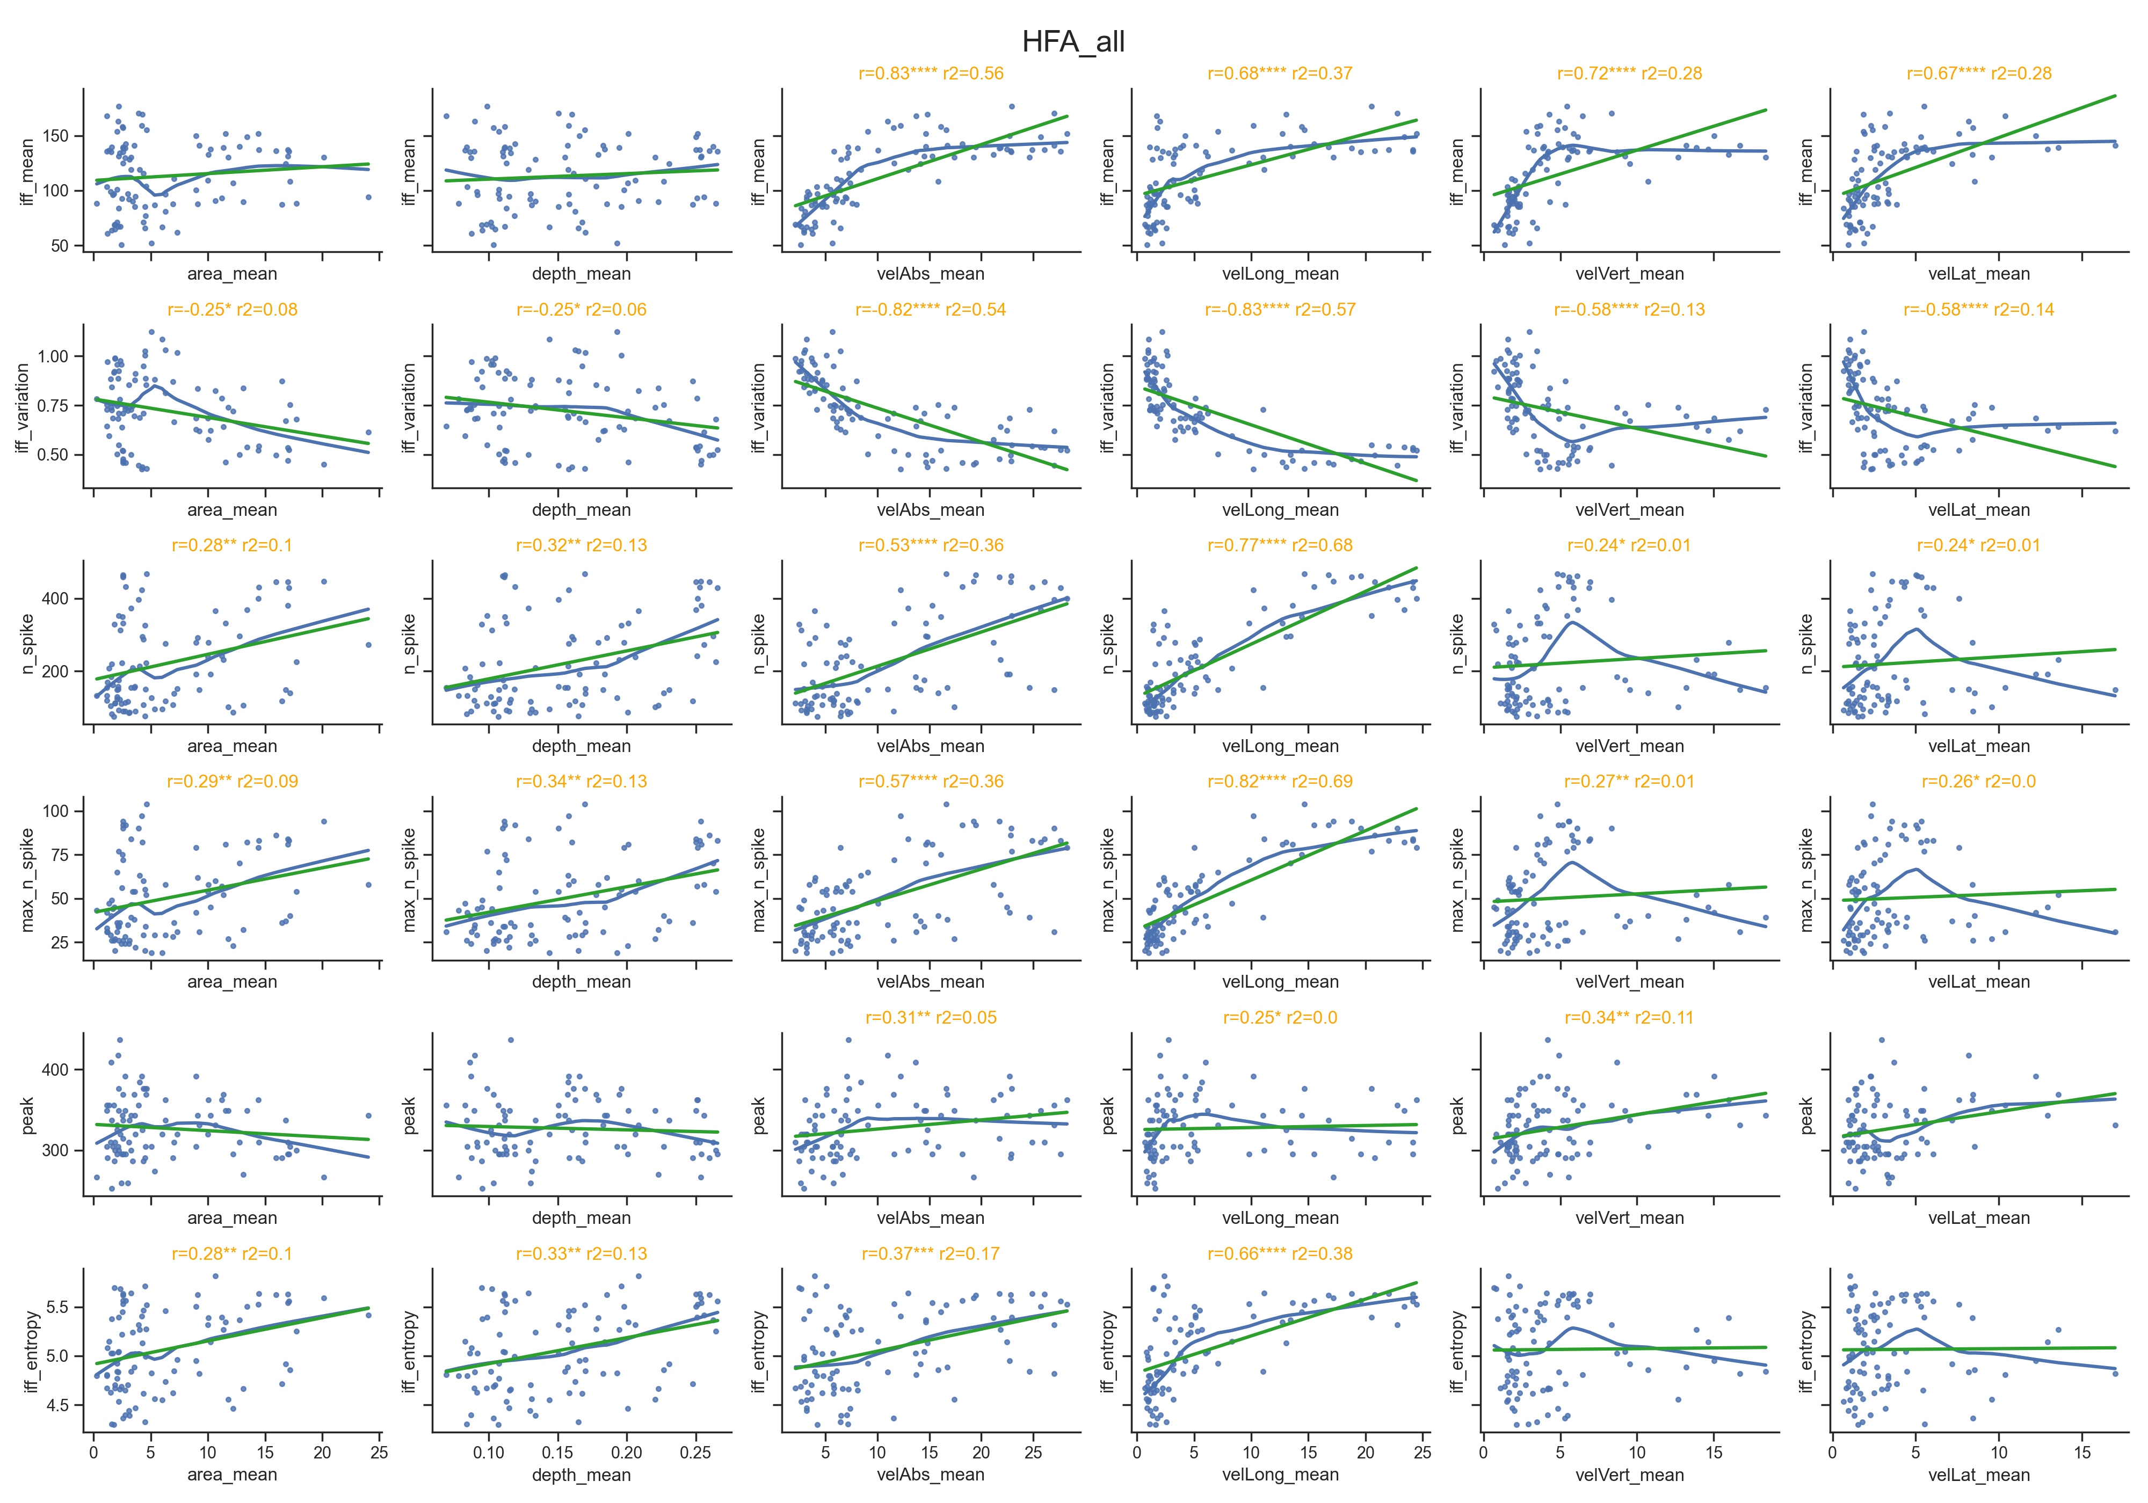
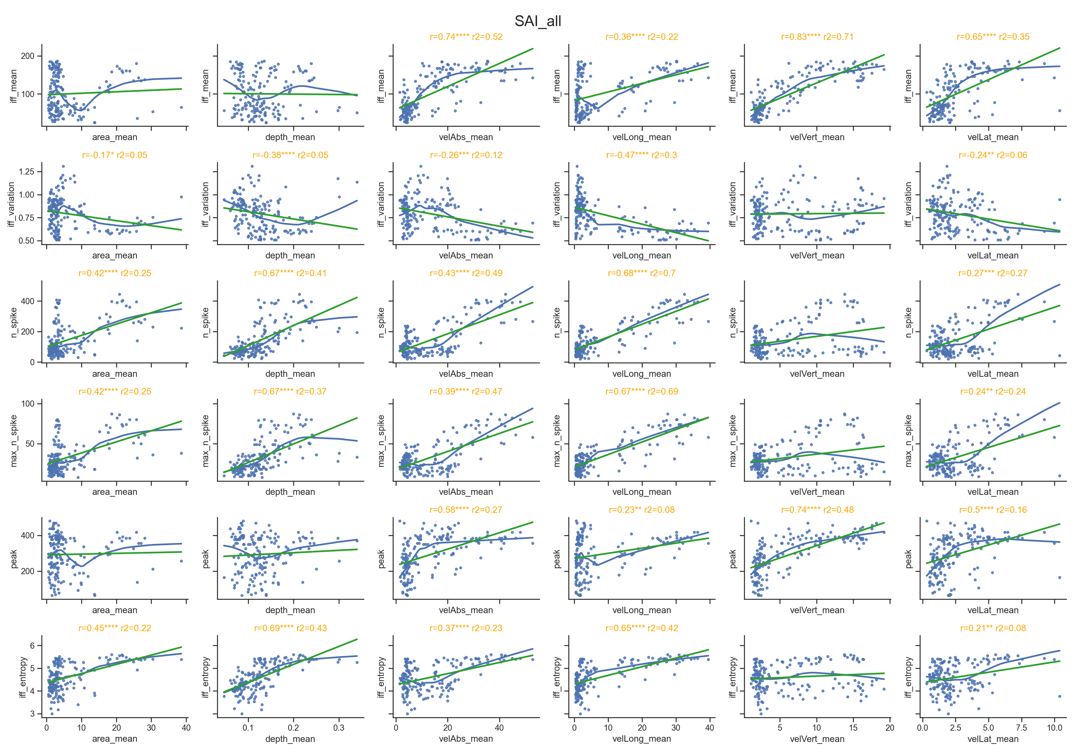
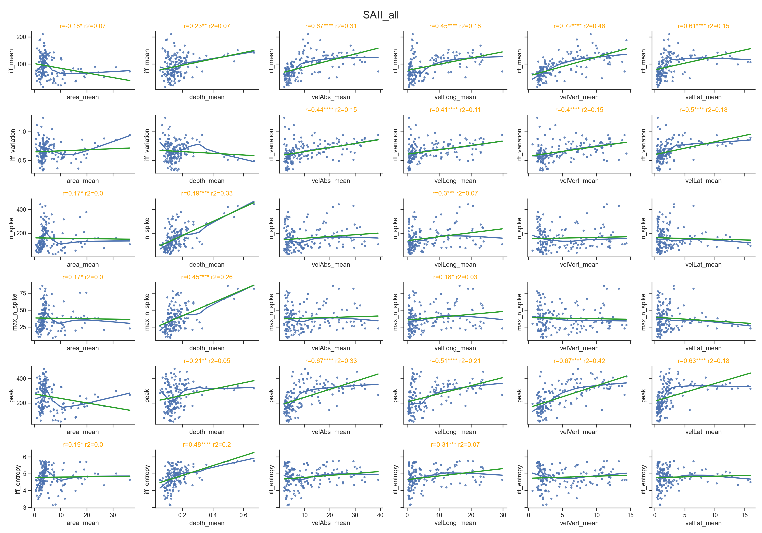

Slide 11
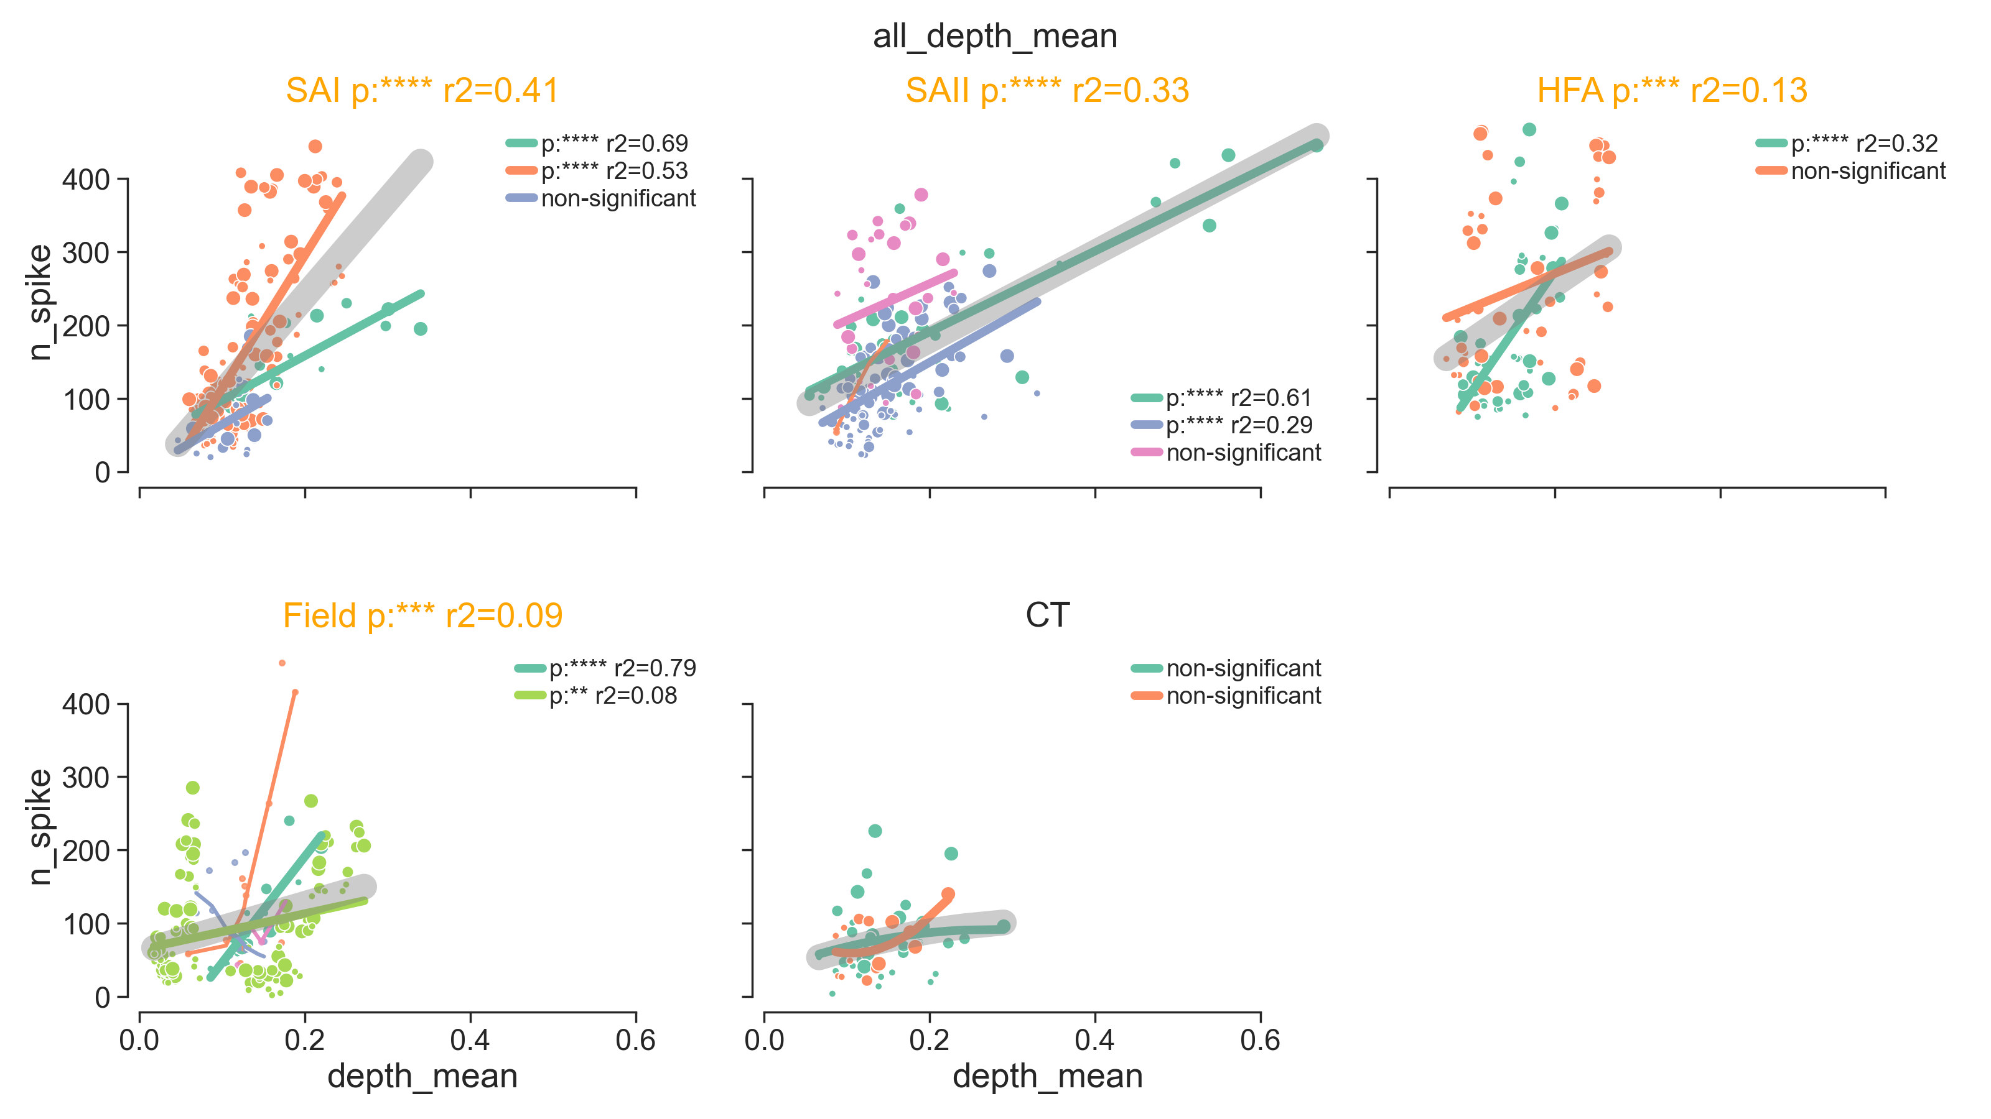

Slide 12
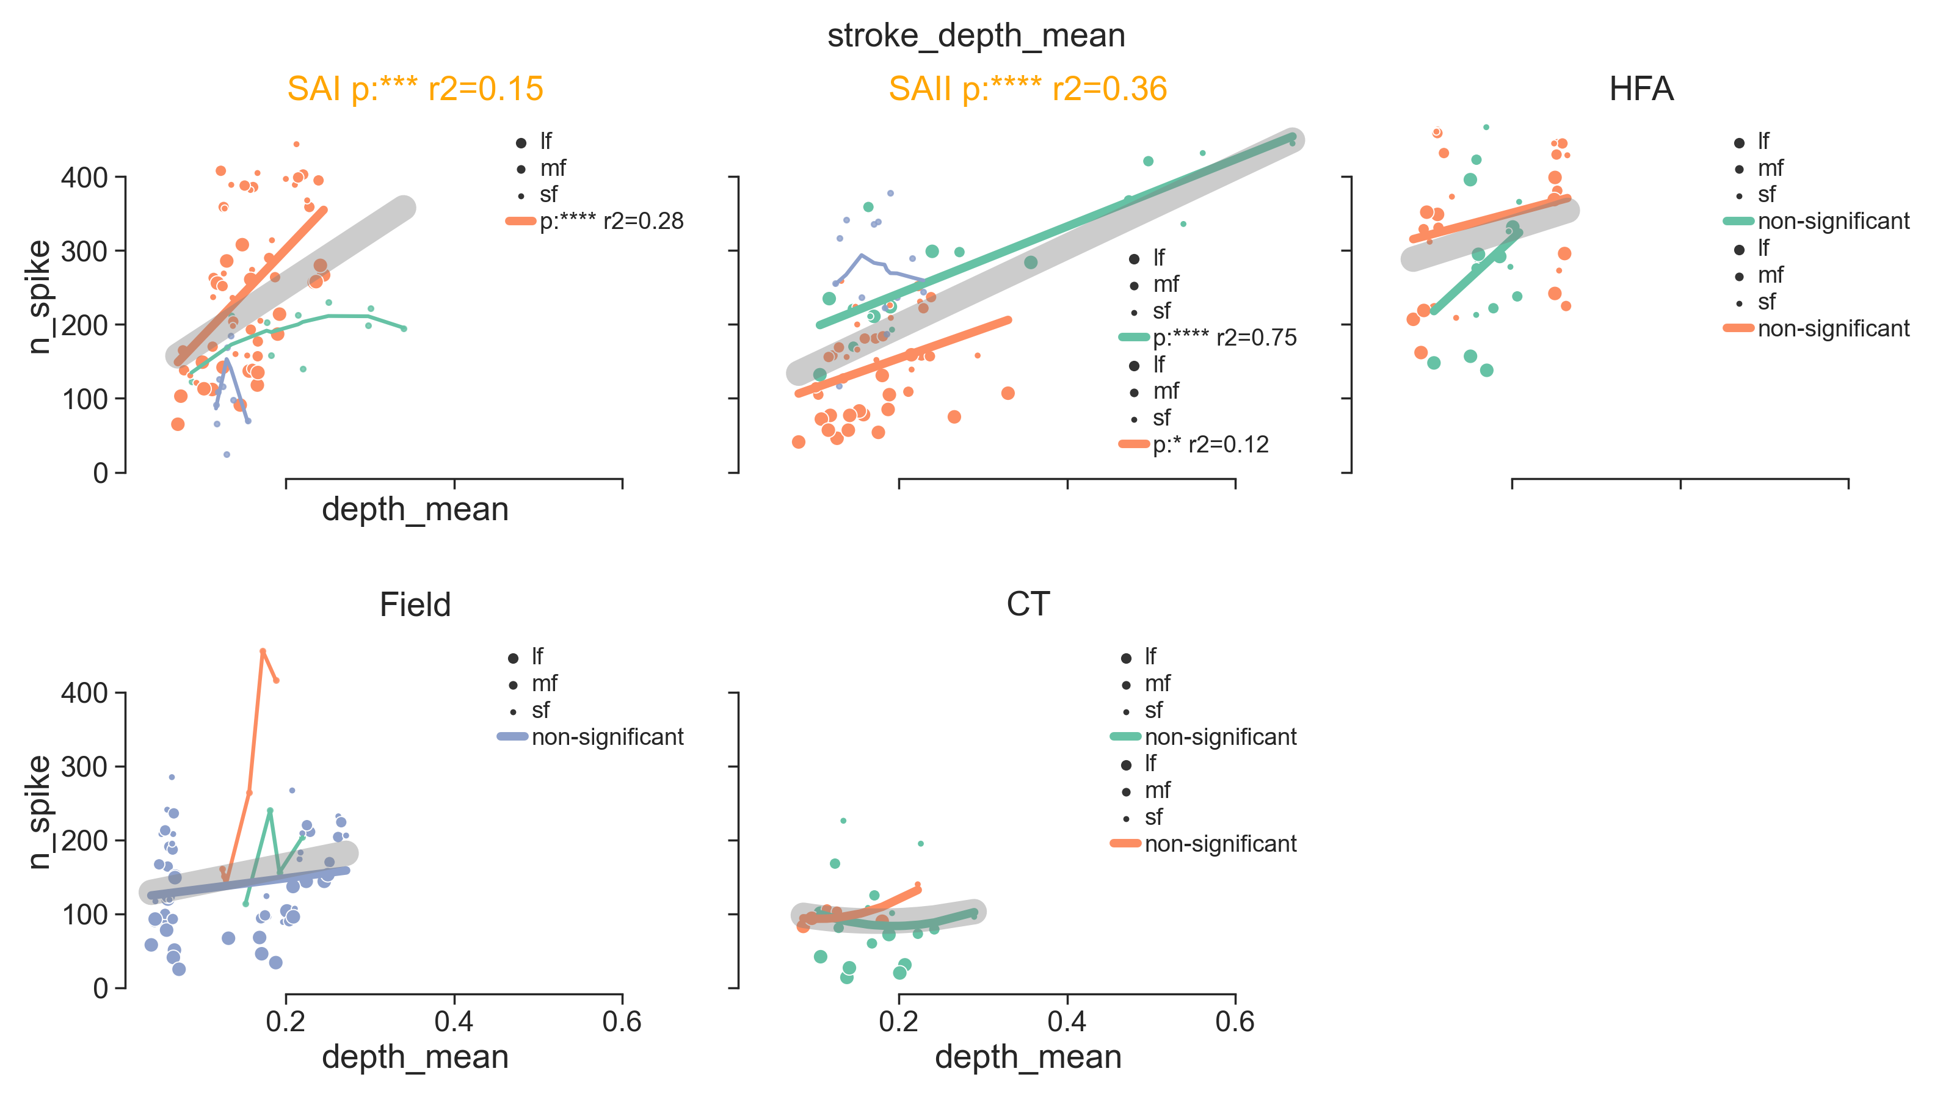
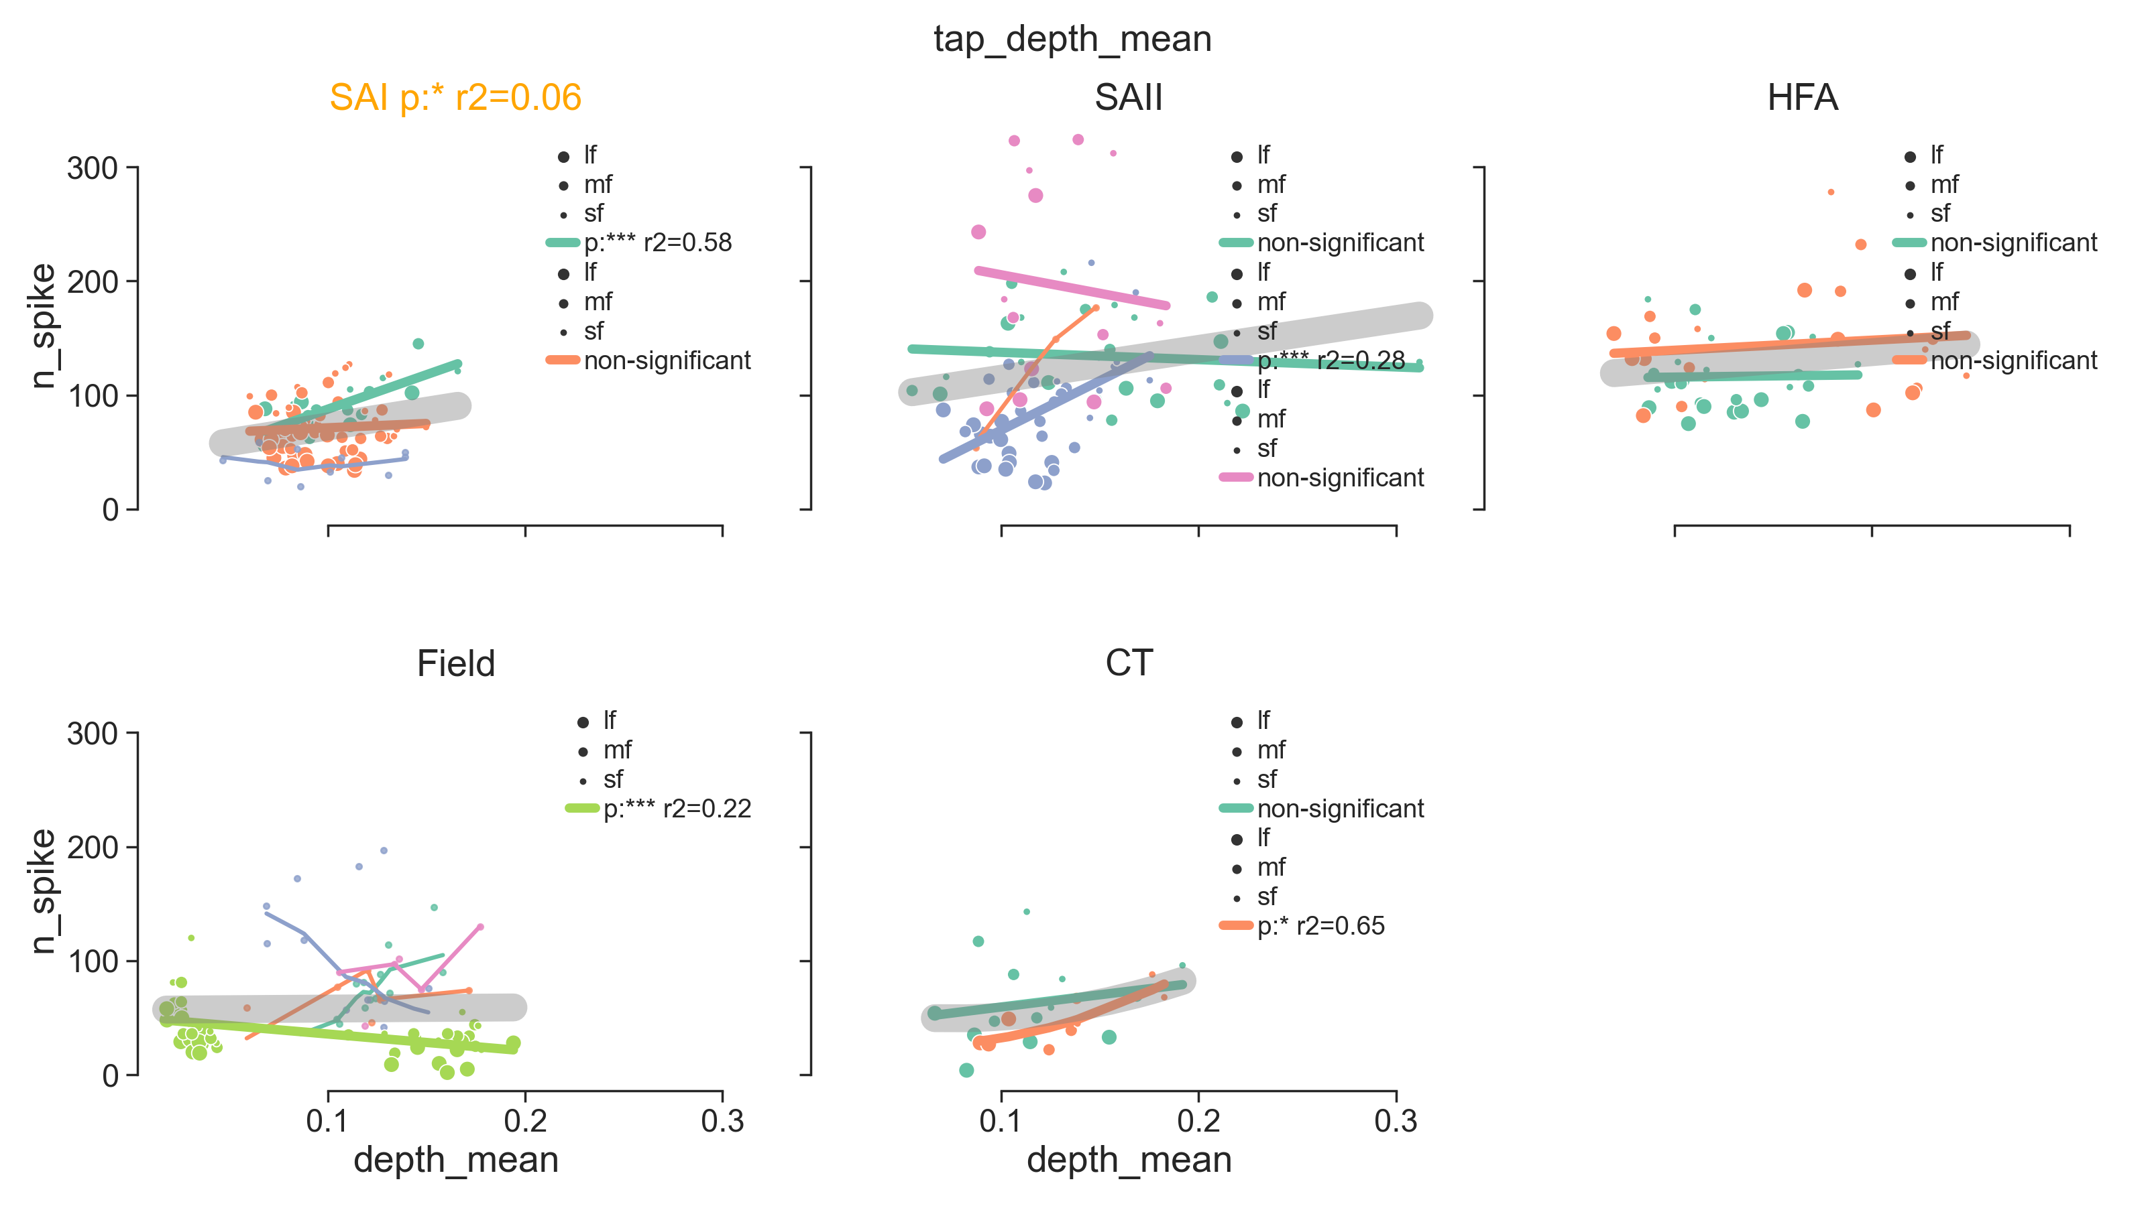
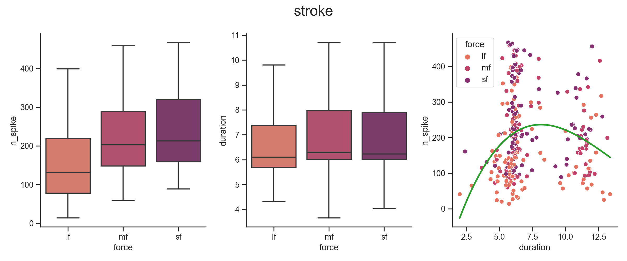
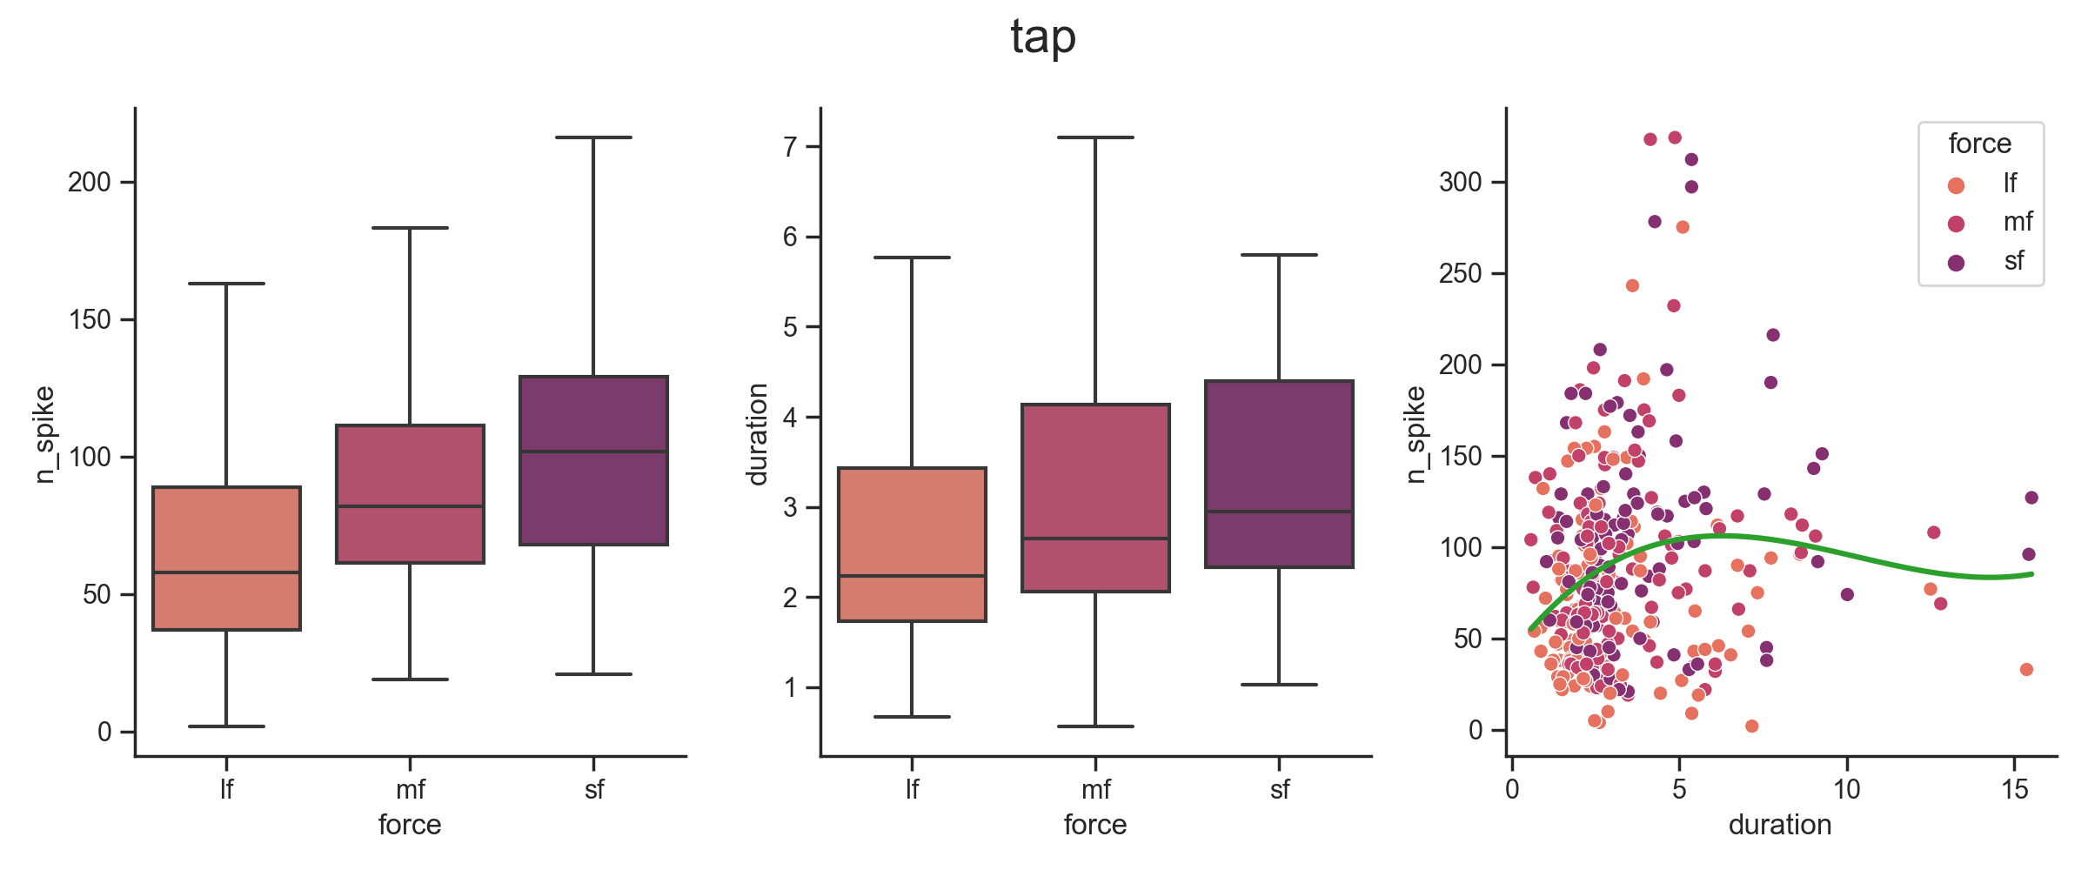
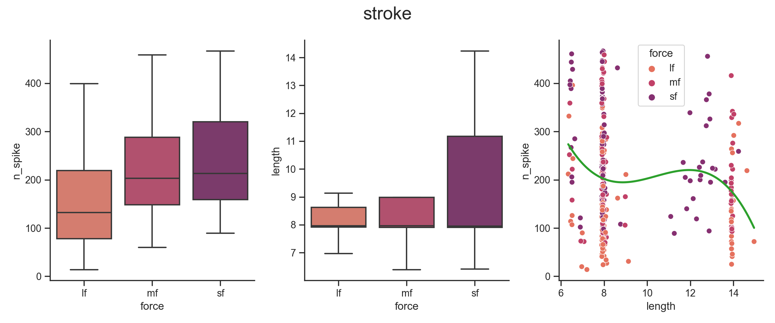
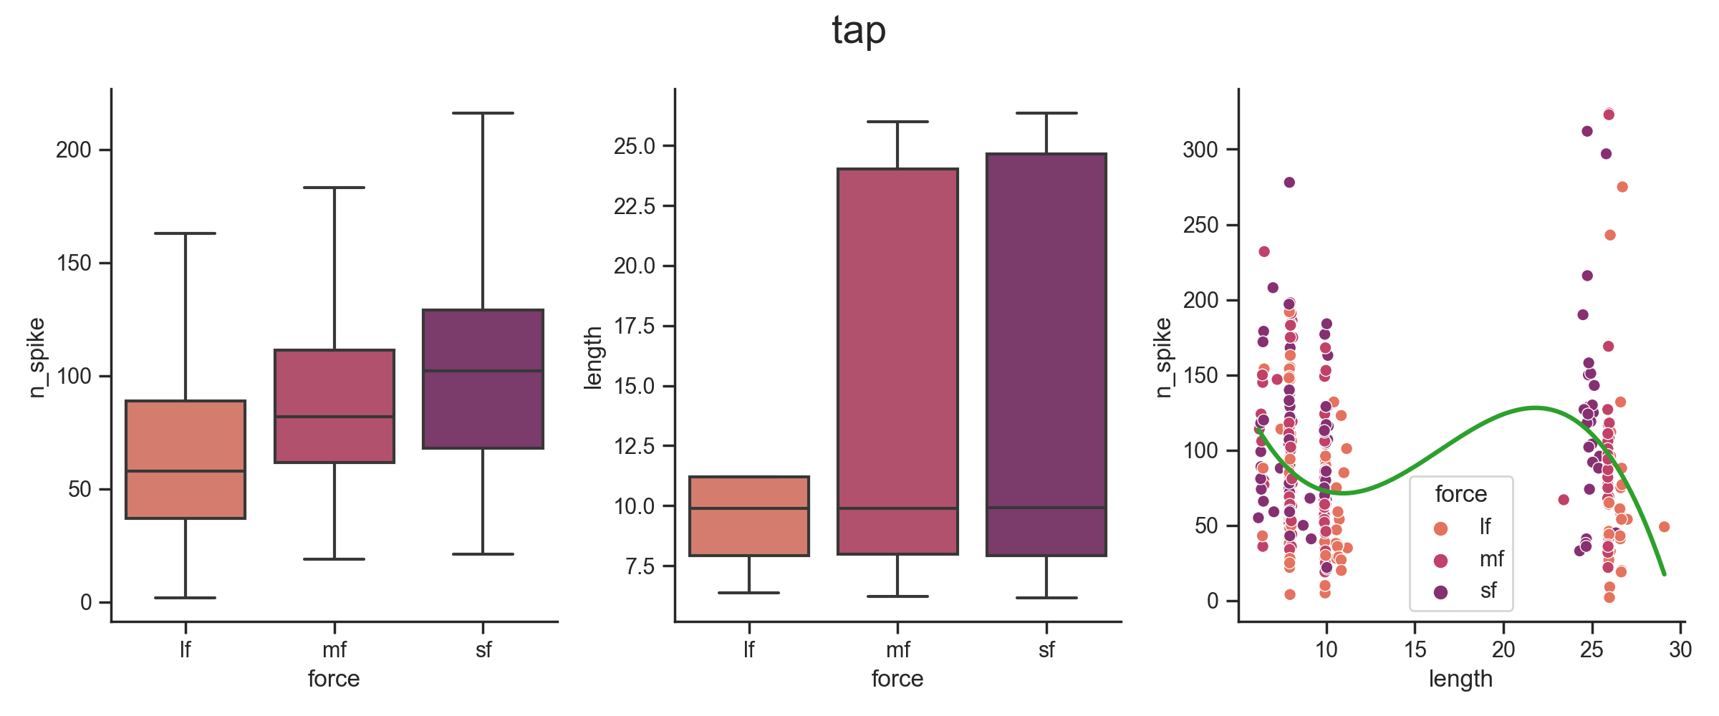

Slide 13
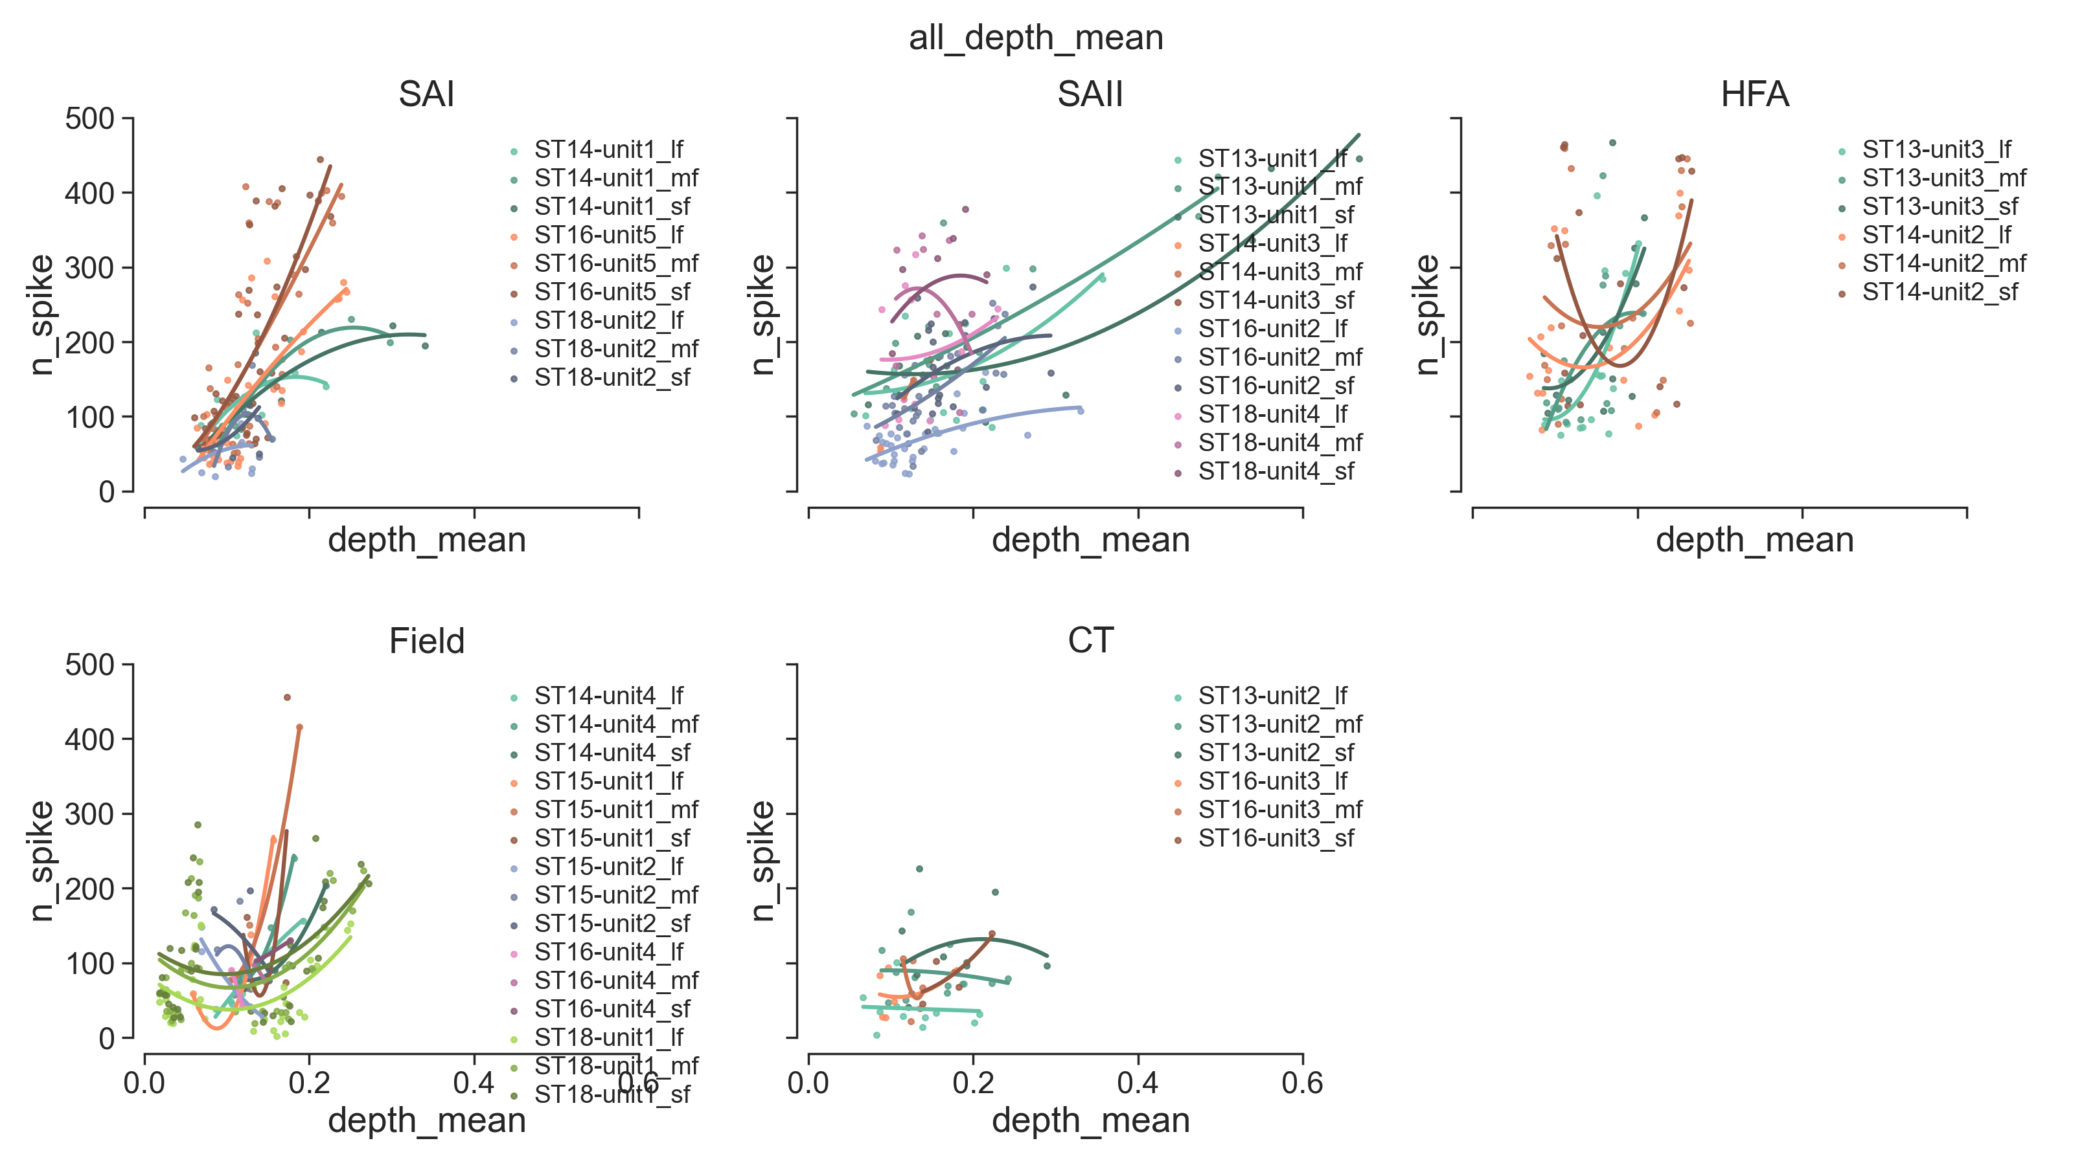

Slide 14
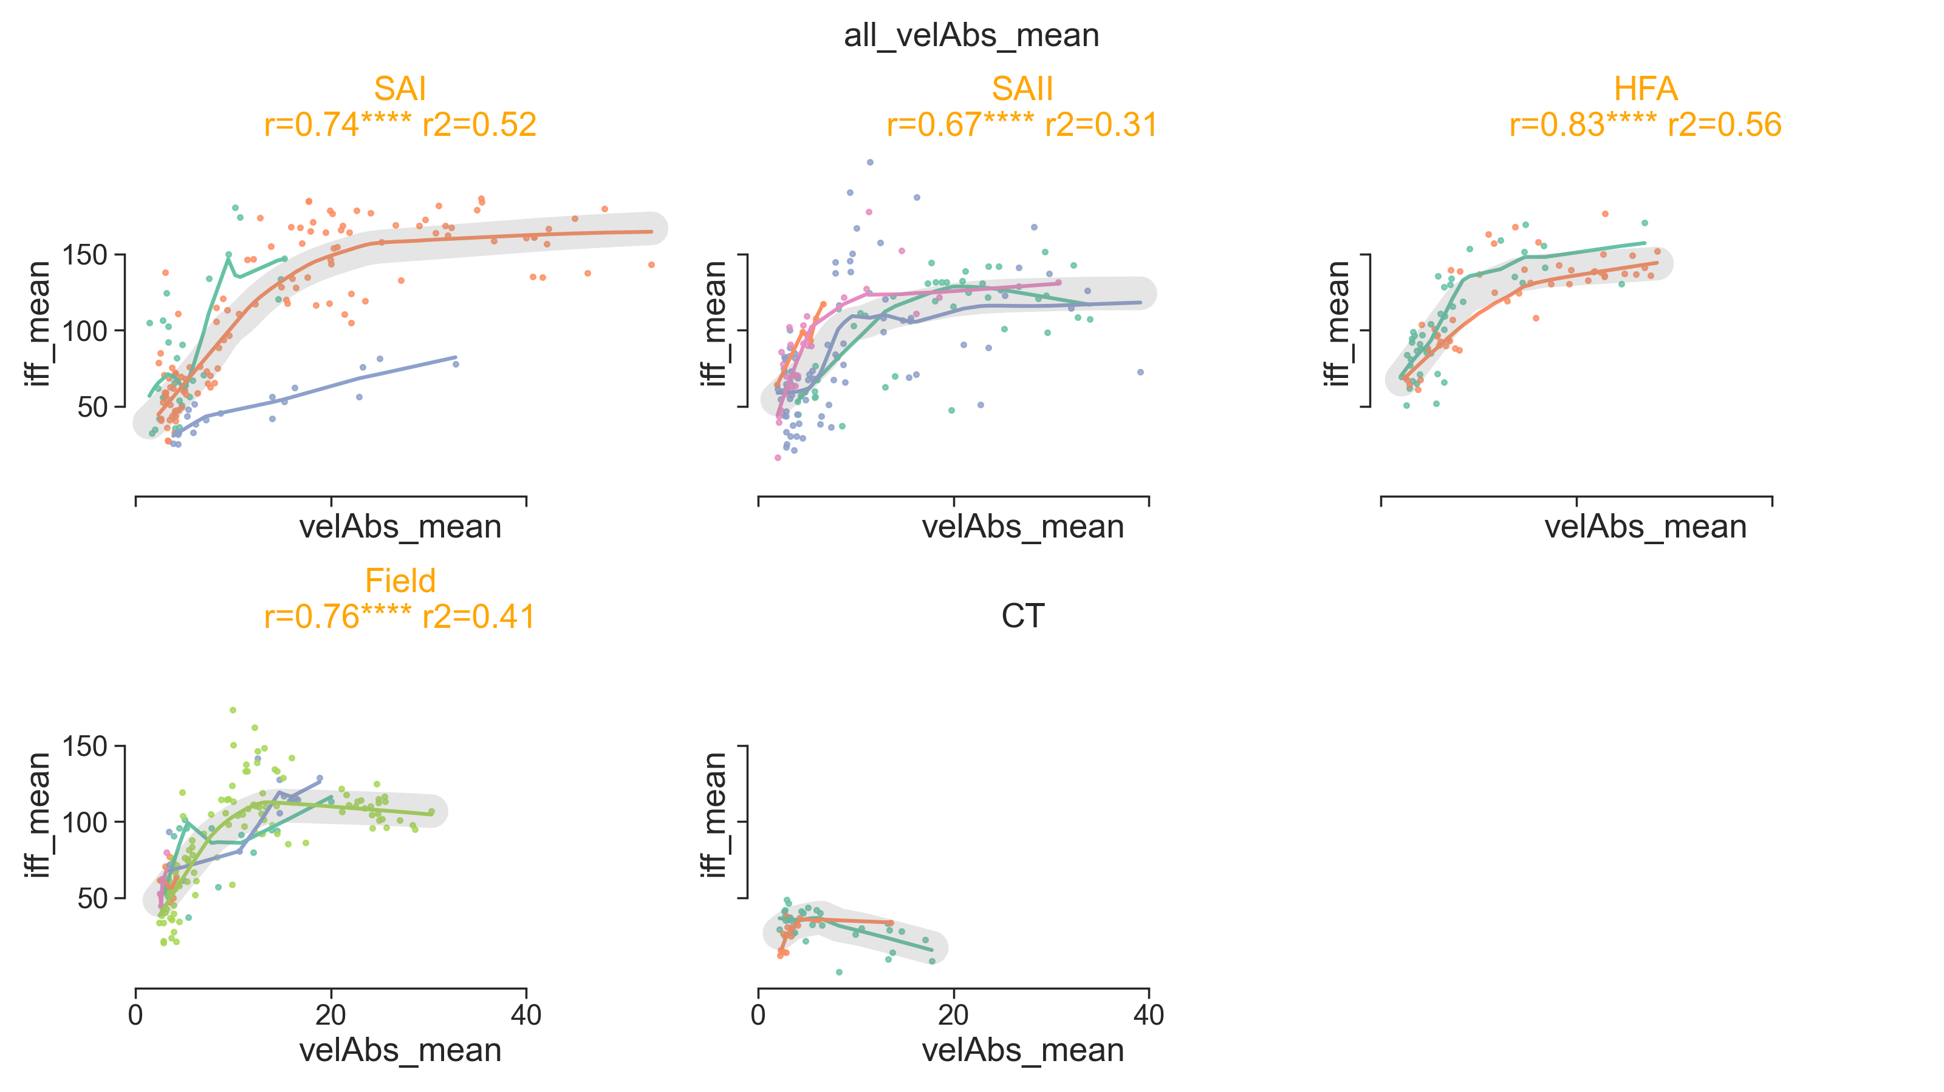

Slide 15
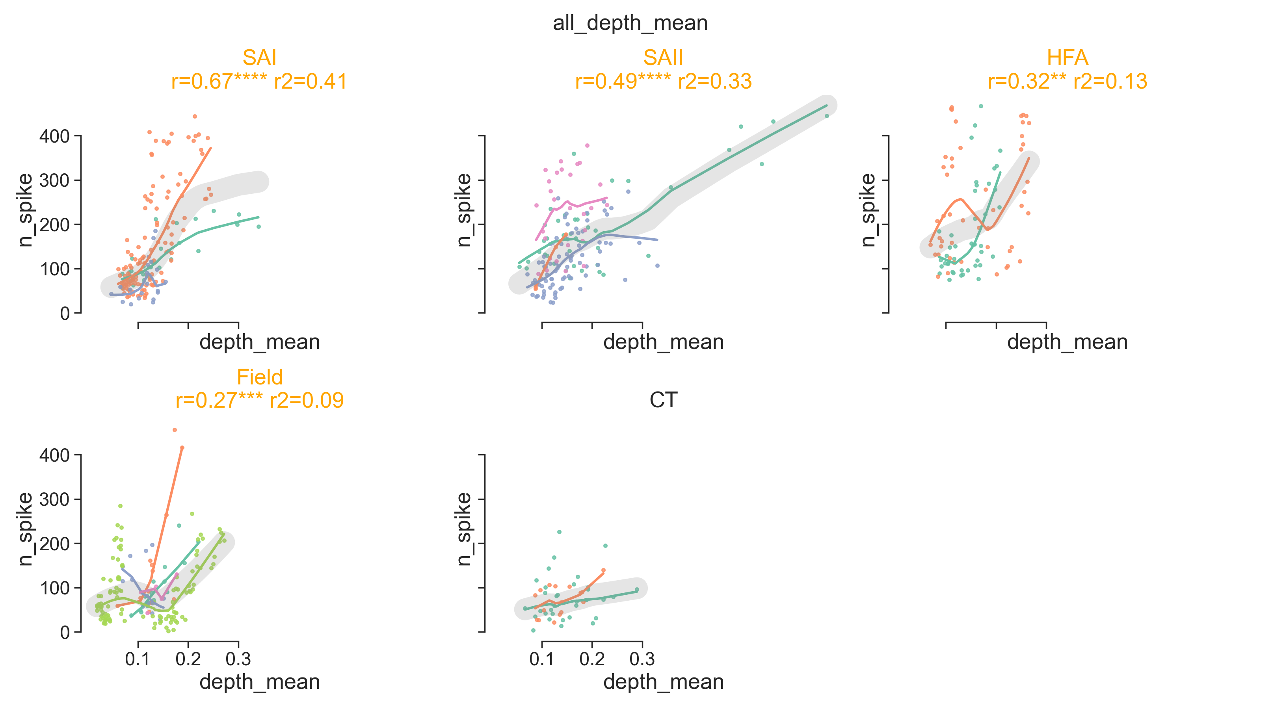

Slide 16
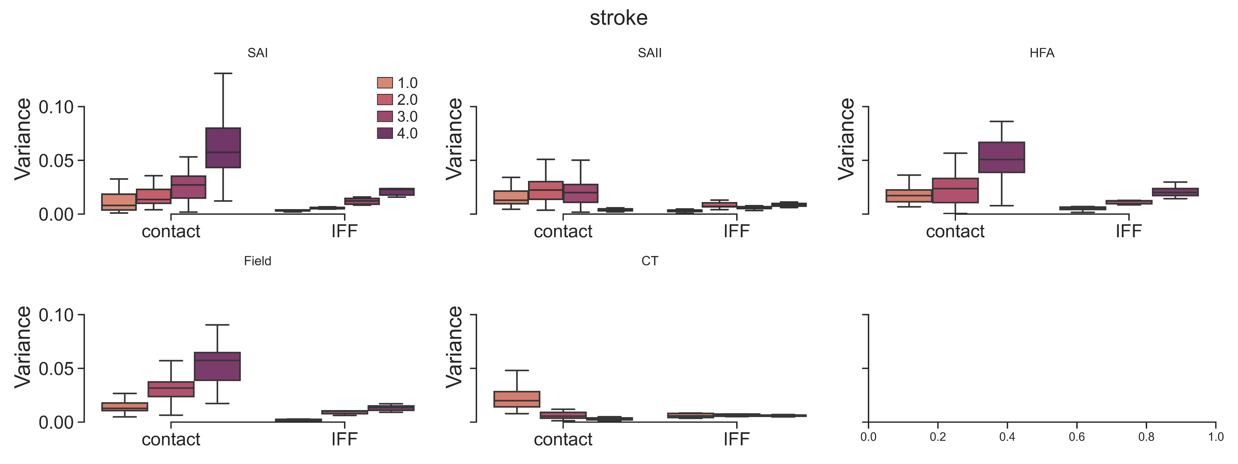
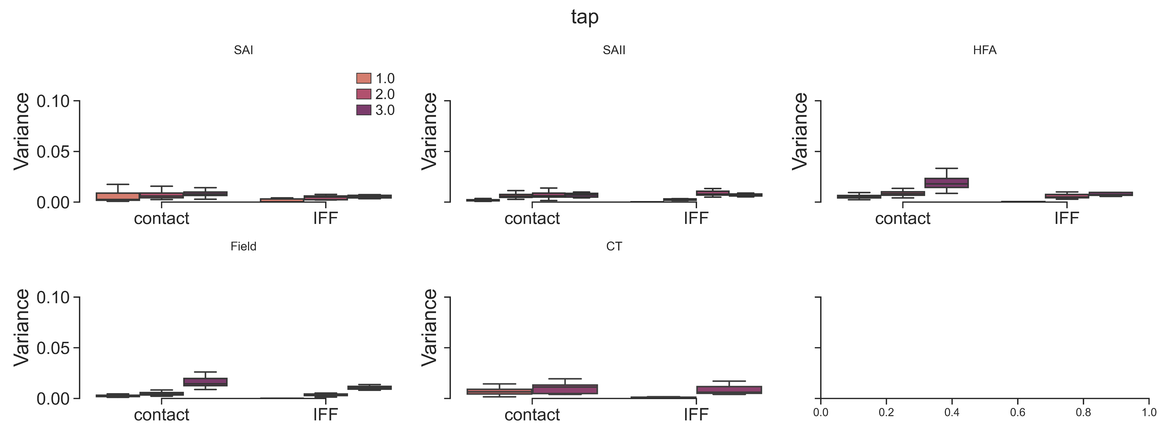
Compare the variance of contact attributes and IFF across controlled contact conditions
SAI
SAII
HFA
Stroking
Field
CT
SAI
SAII
HFA
Tapping
Field
CT
Variance of IFFs exhibits a small range, which is stable regardless of the variance of contact

Slide 17


Slide 18


Slide 19


Compare the variance of contact attributes and IFF across controlled contact conditions

Slide 20

Compare the variance of contact attributes and IFF across controlled contact conditions

Slide 21



Compare the variance of contact attributes and IFF across controlled contact conditions
SAI
SAII
HFA
Stroking
Field
CT
SAI
SAII
HFA
Tapping
Field
CT
Variance of IFFs exhibits a small range, which is stable regardless of the variance of contact

Slide 22

Actual vel label:
IFF features:
iff_mean,
iff_variation,
n_spike,
max_n_spike,
iff_high_qtr,
peak,
iff_entropy,
freq_max,
freq_amp_max,
freq_centroid,
freq_entropy

Slide 23

Actual vel label:
Mean of 6 contact attributes

Slide 24




Actual vel label:
IFF features
iff_mean,
iff_variation,
n_spike,
max_n_spike,
iff_high_qtr,
peak,
iff_entropy,
freq_max,
freq_amp_max,
freq_centroid,
freq_entropy
Actual vel label:
PC1-6
Feature Importance

Slide 25

Actual vel label:
IFF features
iff_mean,
iff_variation,
n_spike,
max_n_spike,
iff_high_qtr,
peak,
iff_entropy,
freq_max,
freq_amp_max,
freq_centroid,
freq_entropy

Slide 26


Actual vel label:
iff_mean,
iff_variation,
n_spike,
max_n_spike,
iff_high_qtr,
peak,
iff_entropy,
freq_max,
freq_amp_max,
freq_centroid,
freq_entropy

Slide 27

Actual vel label:
PC1-6

Slide 28

Actual vel label:
iff_mean,
iff_variation,
n_spike,
max_n_spike,
iff_high_qtr,
peak,
iff_entropy,
freq_max,
freq_amp_max,
freq_centroid,
freq_entropy

Slide 29



Slide 30

Actual vel label:
PC1-6

Slide 31






Slide 32






Slide 33






Slide 34






Slide 35





Linear Regression
Linear Nonlinear Poisson
Fit linear filter (conv kernel)
Invert Poisson link

Slide 36





















Linear Regression
Linear Nonlinear Poisson
Fit linear filter (conv kernel)
Invert Poisson link
0.05 s bin
0.15 s bin
0.4 s bin

Slide 37
Stroking
Tapping

Slide 38


SAI

Slide 39

HFA

Slide 40



Actual vel label

Slide 41



KMeans
Combiend_ges

Slide 42



VarGaussianMix
Combined_ges

Slide 43





Actual vel label
CNN with 7000 ms spike train (Actual vel label)
RF with IFF 6 features

Slide 44





VarGaussianMix
CNN with 7000 ms spike train (Actual vel label)
RF with IFF 6 features

Slide 45





CT
Field
HFA
SAI
SAII

Slide 46





CT
Field
HFA
SAI
SAII

Slide 47


Slide 48


Slide 49


Slide 50


Slide 51


Slide 52




